Slide 1
Simulation and Analysis of Ship Trajectories
Group 5
Vineet Kumar Agarwal
Nishanth Battu
Aishwarya Chincholi Vasant Madhav
Supervisor: Taruna Tiwari
Autonomous Multisensor Systems Group
Institute for Intelligent Cooperating Systems
Faculty of Computer Science
Otto von Guericke University Magdeburg
16.09.2025

Slide 2
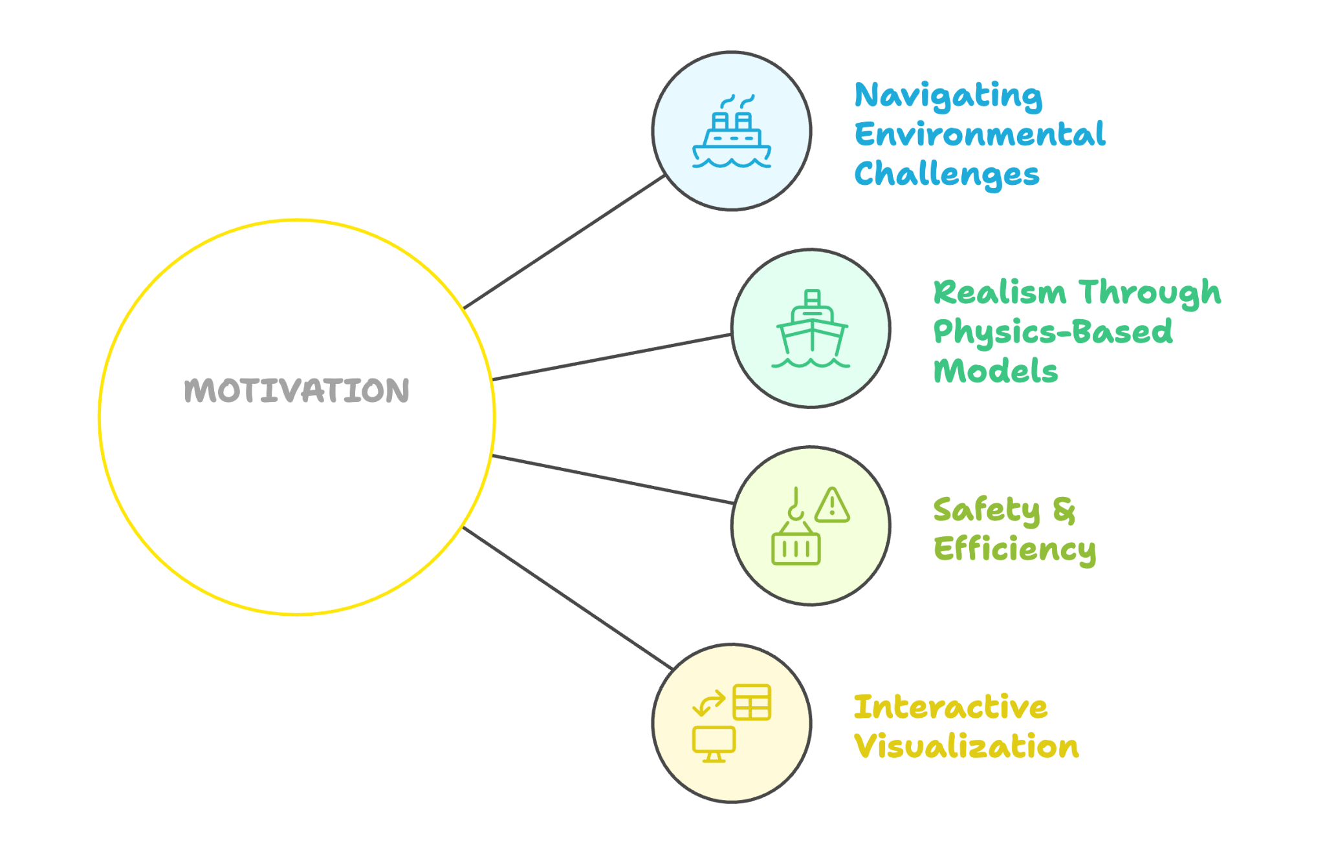
Motivation
Presentation of Final Results | Vineet Kumar Agarwal

Slide 3
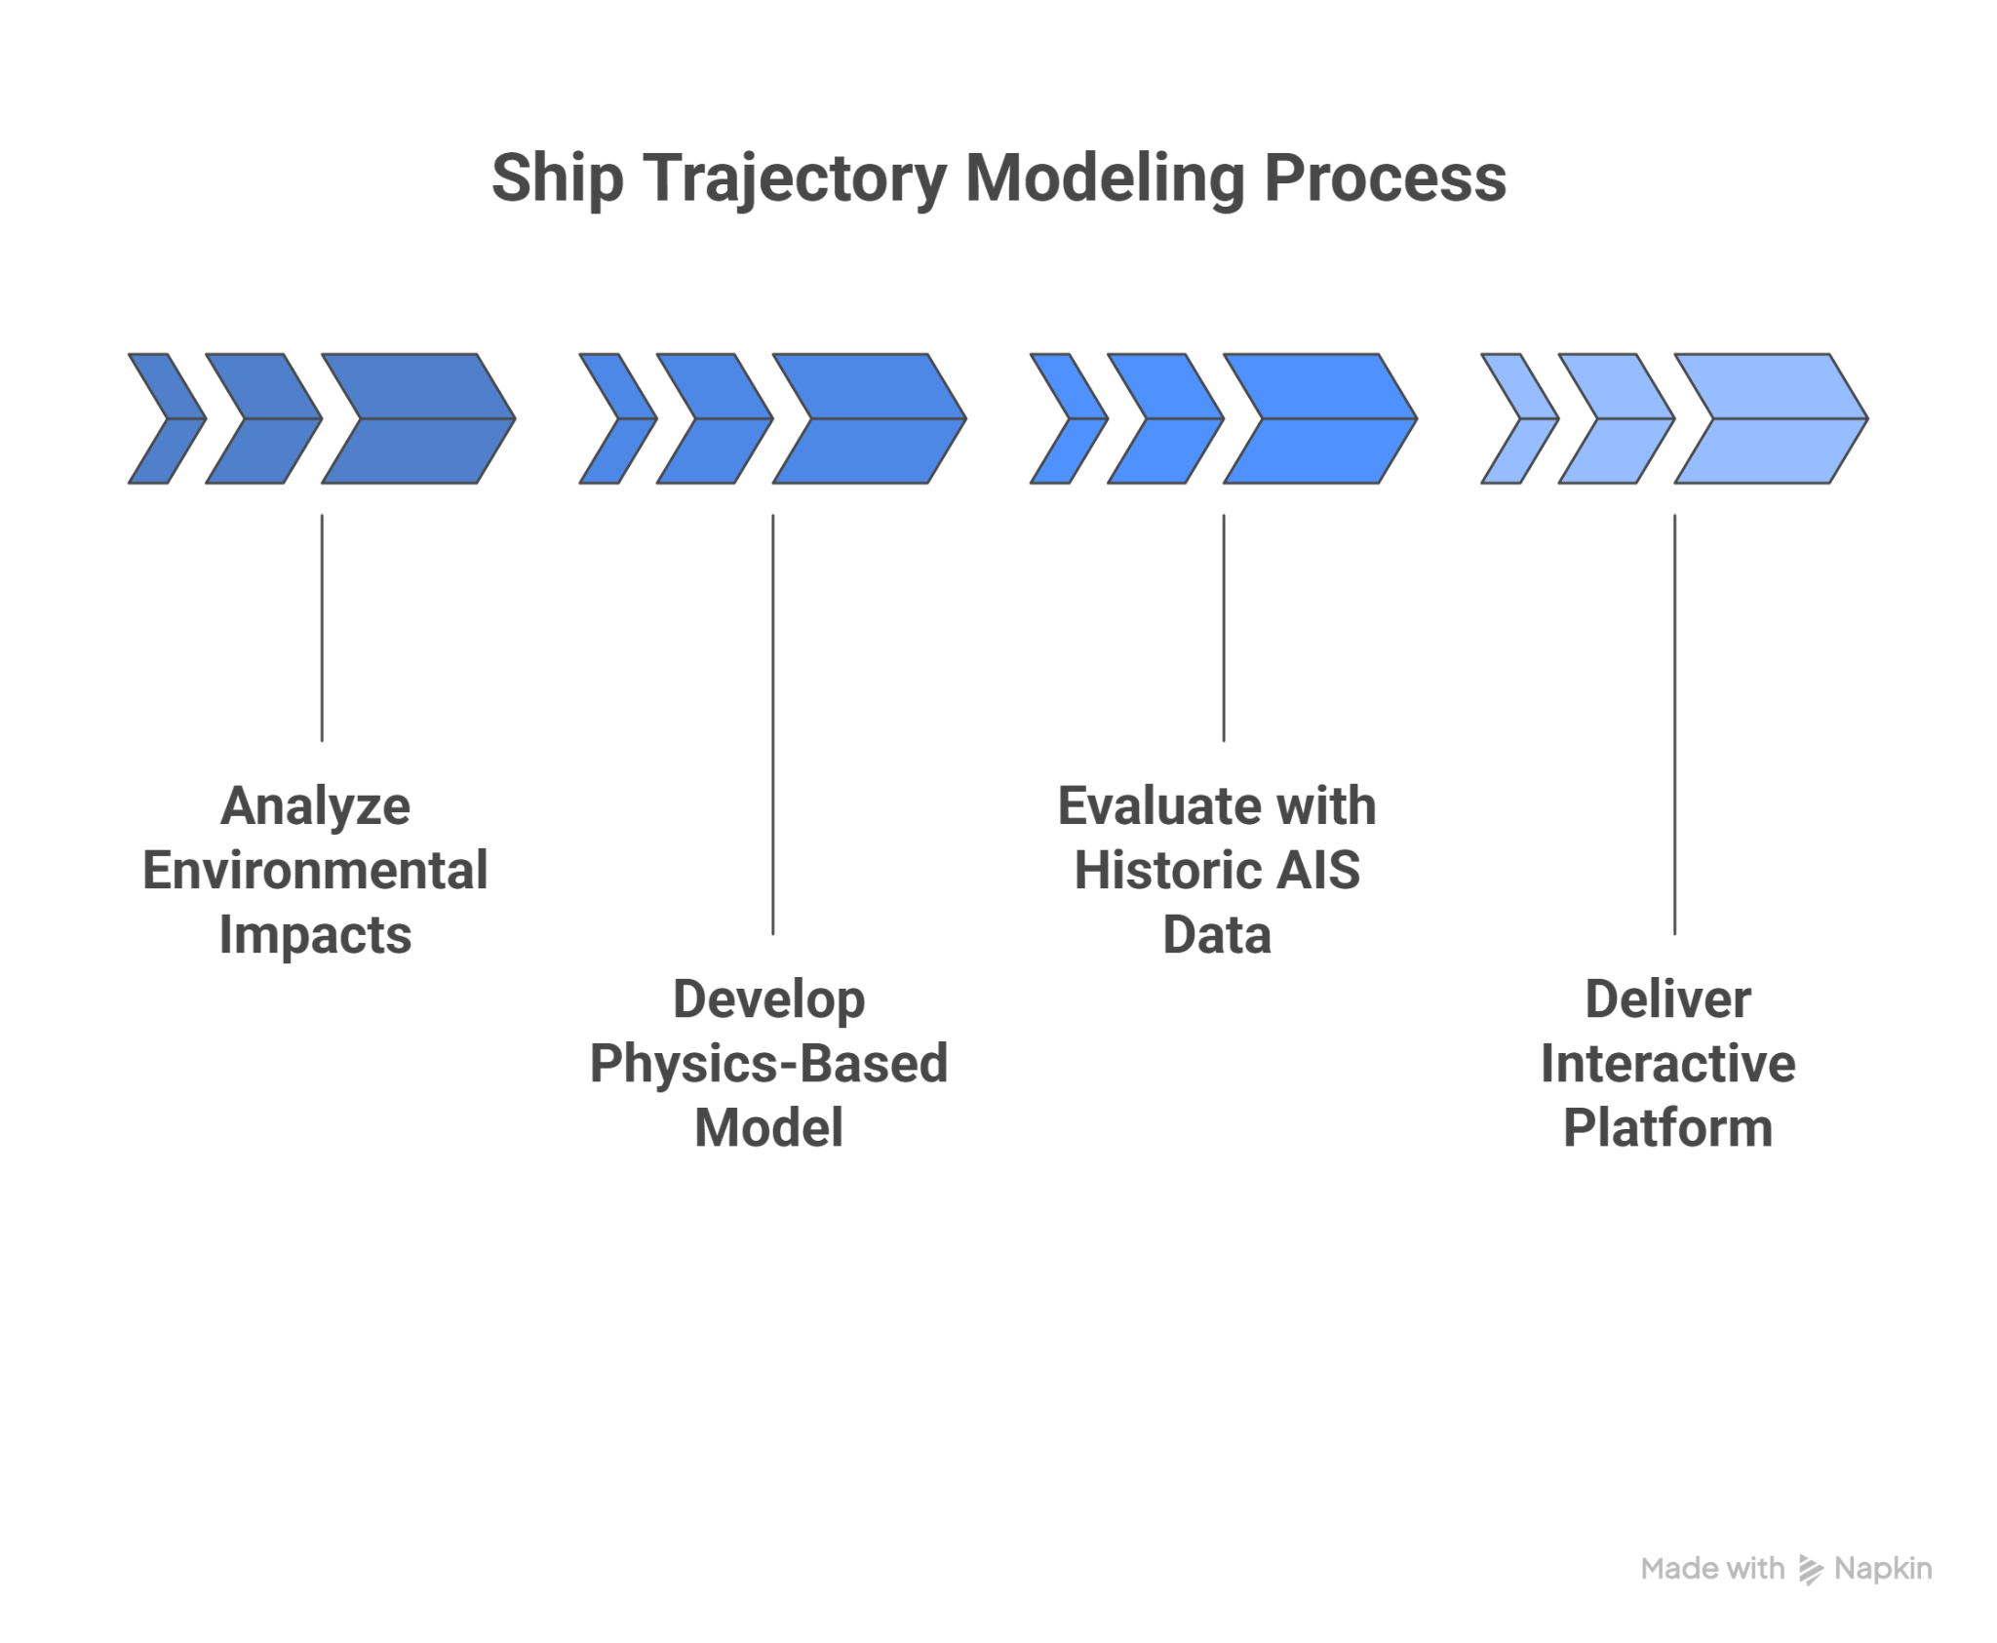
Project Plan
Presentation of Final Results | Vineet Kumar Agarwal

Slide 4
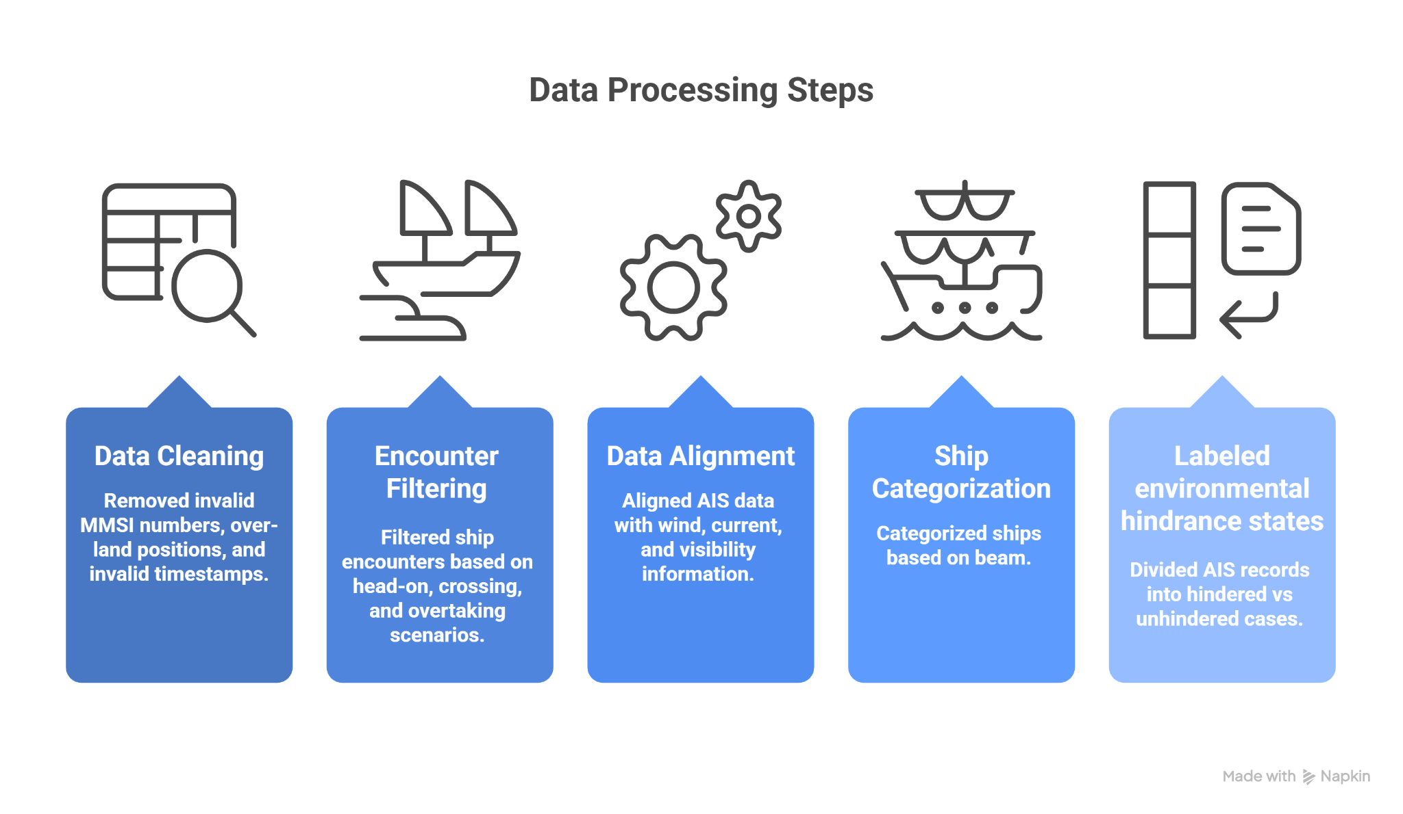
Data Processing
Presentation of Final Results | Aishwarya Chincholi Vasant Madhav

Slide 5
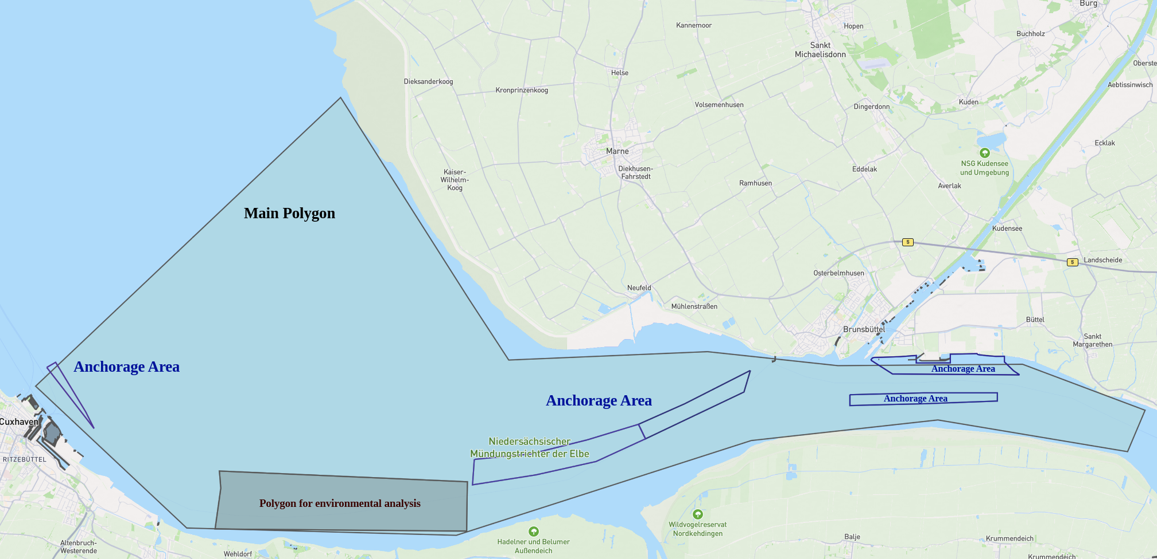
Cuxhaven Region- Area Selection
Source for anchorage and port : https://overpass-turbo.eu/
Presentation of Final Results | Aishwarya Chincholi Vasant Madhav

Slide 6
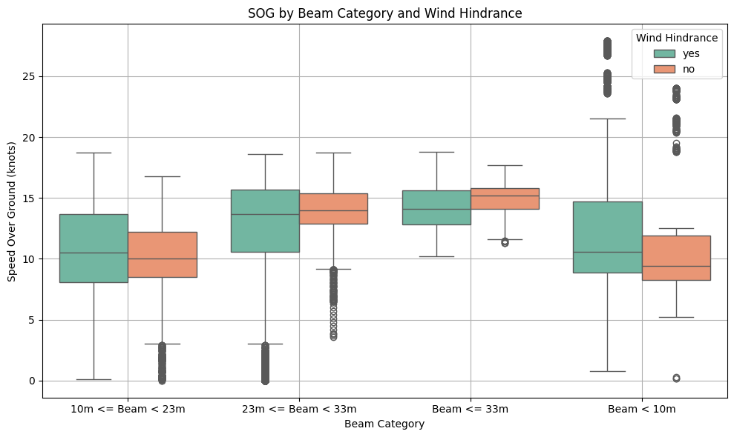
Environmental Analysis - Cuxhaven
Aspect | Our Findings | Zhou’s Findings [6][7]
Wind effect on speed | Very small changes | Very small, inconsistent
Wind size sensitivity | Small vessels slightly faster, large ~1 kn | Small vessels variable, large slightly slower (windage)
Presentation of Final Results | Aishwarya Chincholi Vasant Madhav

Slide 7
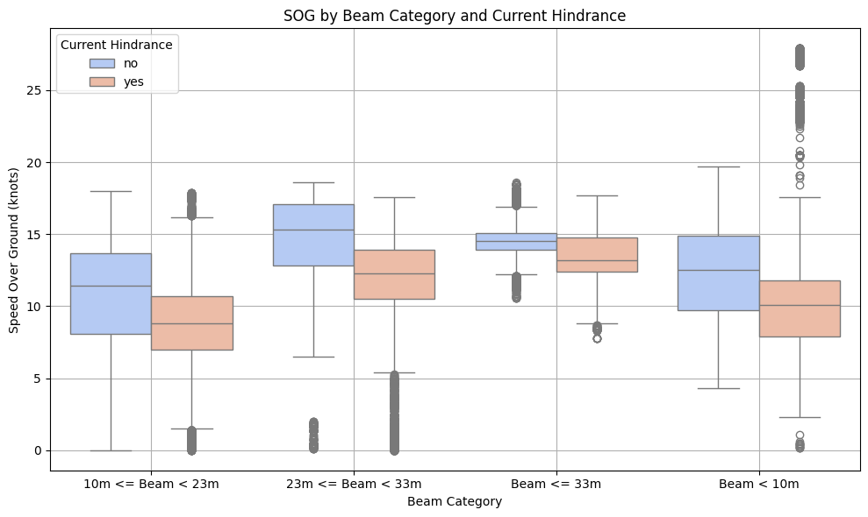
Environmental Analysis - Cuxhaven
Aspect | Our Findings | Zhou’s Findings [6][7]
Current magnitude | Clear slowdown | Clear SOG impact
Current size pattern | Mid > small > large | Small > ↓ mid > ↑ large
Presentation of Final Results | Aishwarya Chincholi Vasant Madhav

Slide 8
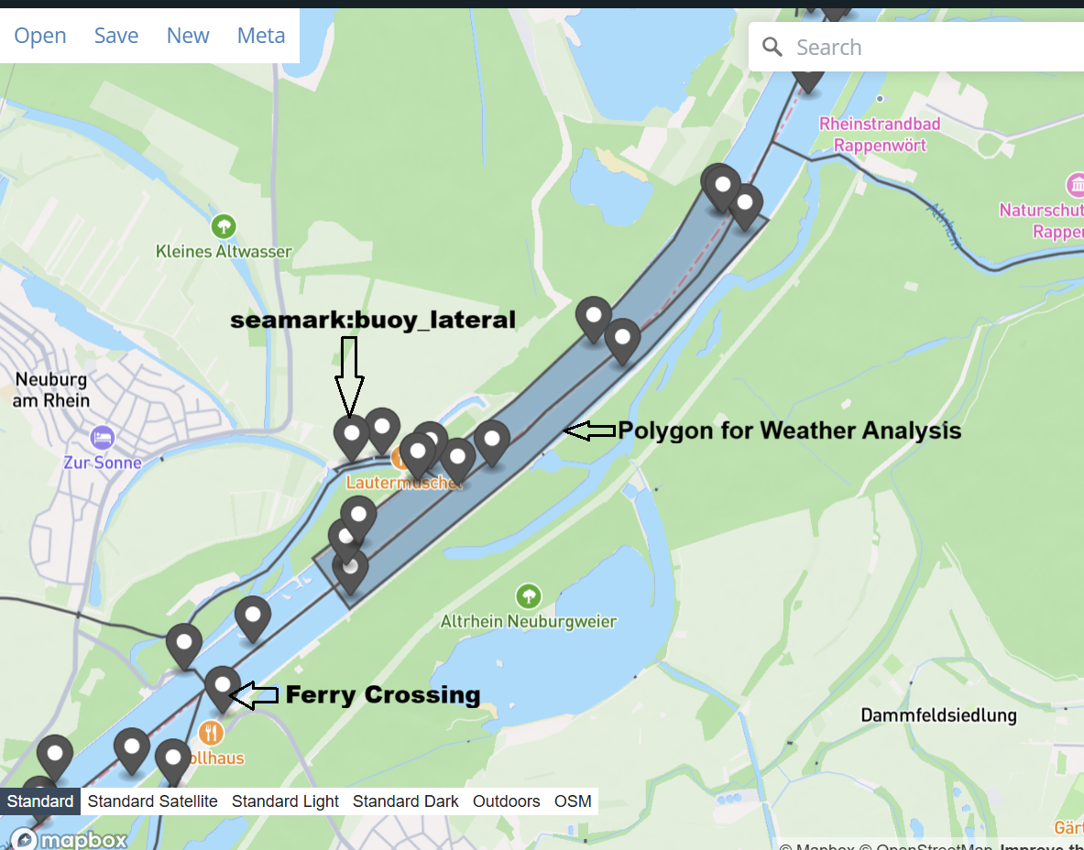
Rheinhafen Region - Area Selection
Source: https://overpass-turbo.eu/
Presentation of Final Results | Aishwarya Chincholi Vasant Madhav

Slide 9
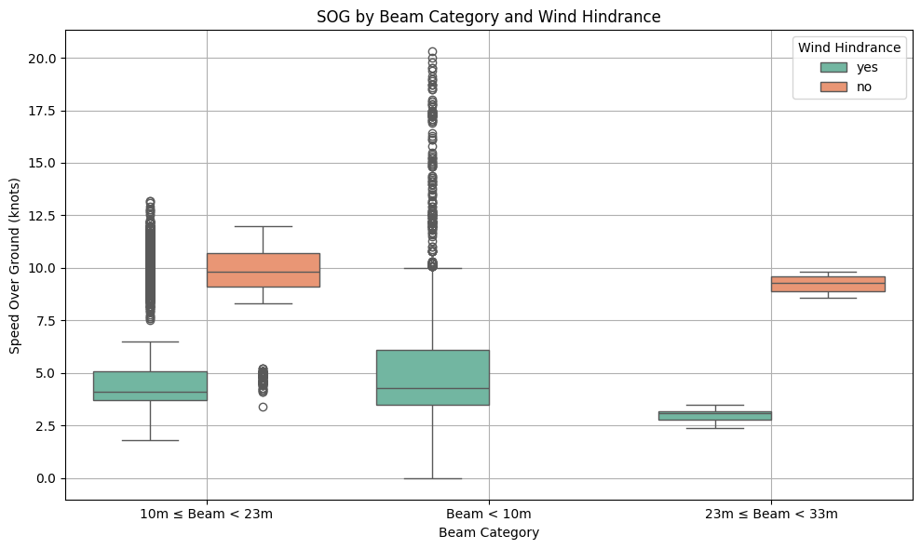
Environmental Analysis - Rheinhafen
Wind hindrance reduces speeds by 4–6 kn (50–65%)
Inbound: Very slow (~5 kn), −0.86 kn under wind
Outbound: Fast (~10 kn), no slowdown (+0.14 kn)
Aspect | Our Findings | Zhao’s Findings [6][7]
Wind effect on speed | Large slowdown (−4 to −6 kn) | Wind has stronger impact in confined/shallow channels
Beam sensitivity | Very strong — Small to Mid-beam (10m to 33m) vessels slow from 9–10 kn to 3–4 kn | Beamier mid-size ships more affected.
Presentation of Final Results | Aishwarya Chincholi Vasant Madhav

Slide 10
Methodology
Presentation of Final Results | Nishanth Battu

Slide 11
Physics Based Model
Formula Based Modeling
Regression problem.
Fairway water line as line of sight guidance mechanism.
Ship Parameters
Weather Data
Physics Based Model
Output:
Position, Speed, Heading
Start
End
Presentation of Final Results | Nishanth Battu

Slide 12
Methodology
What do we need?
Presentation of Final Results | Nishanth Battu

Slide 13
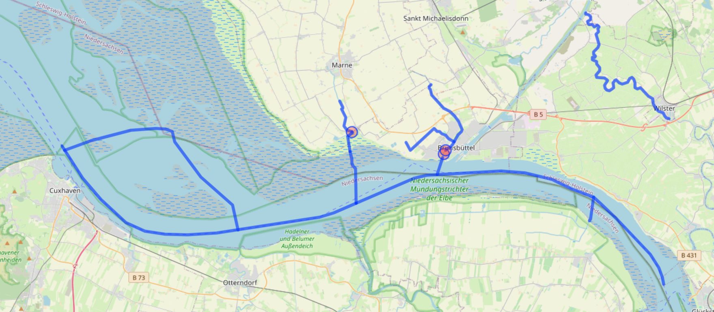
Fairway lines for Cuxhaven
Source : https://overpass-turbo.eu/
Presentation of Final Results | Nishanth Battu

Slide 14
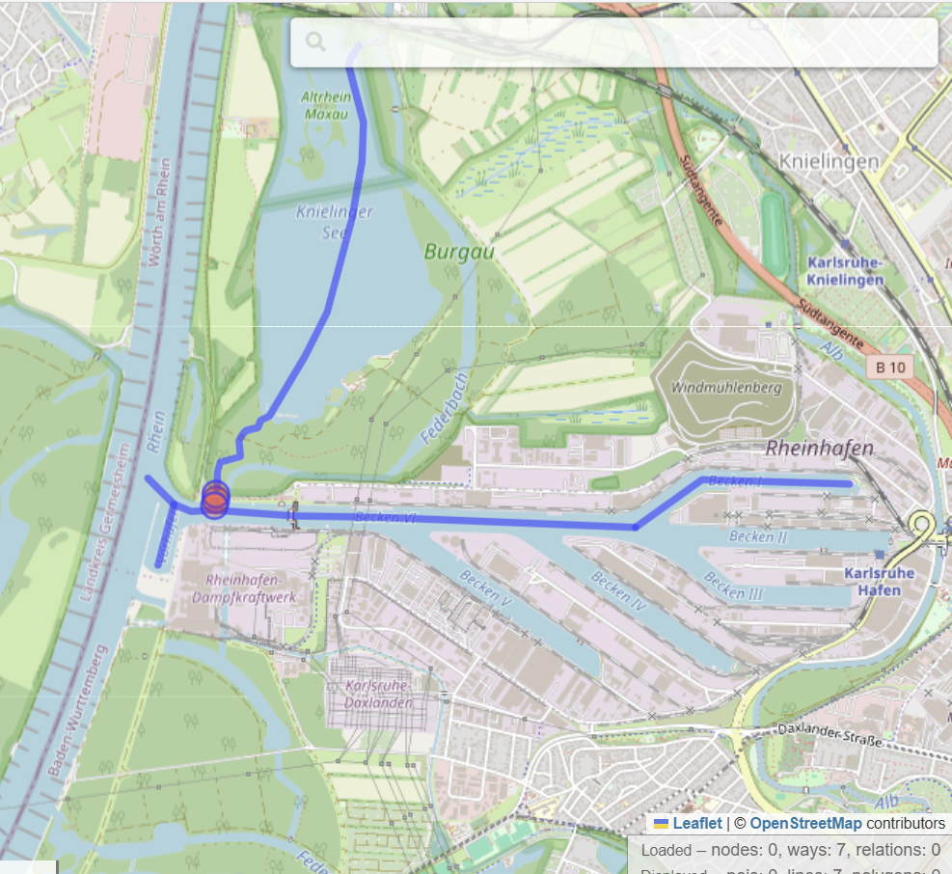
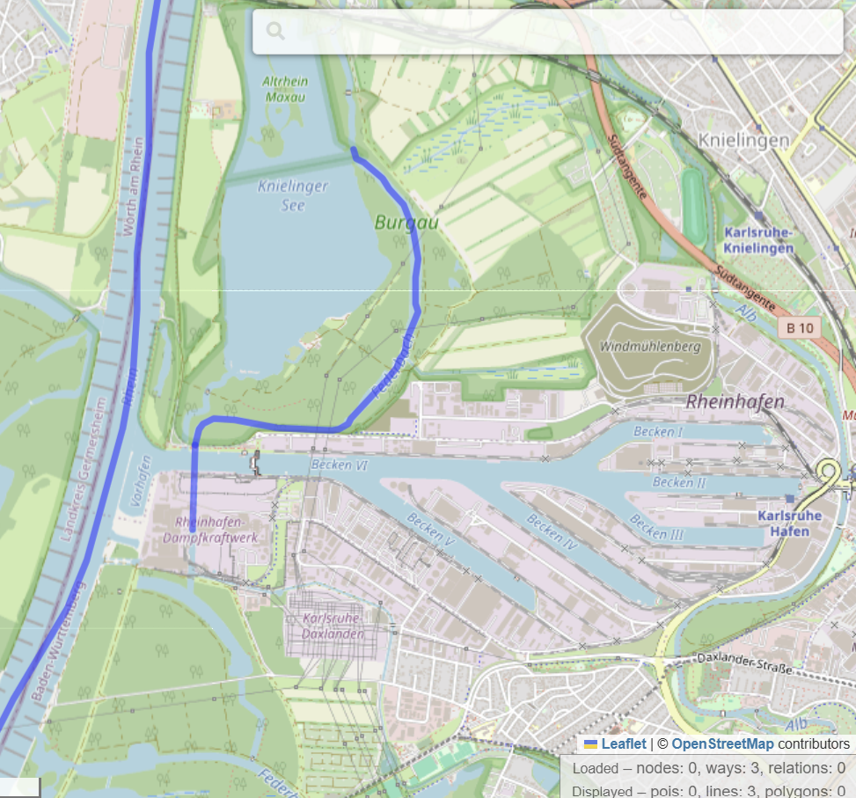
Fairway lines for Rheinhafen
Canals
Rivers
Source : https://overpass-turbo.eu/
Presentation of Final Results | Nishanth Battu

Slide 15
Ship Parameters
Hull drag coeff(CD)
Wetted surface area(S)
Thrust deduction factor(tp)
Wake fraction(w)
Rudder area(AR)
Rudder lift coefficient(CL)
Rudder drag coefficient(CD)
Parameter to control rudder angle(k)
Rudder distance from CG(xR)
Automatic System Identification and Global Optimization (CMA-ES) method.[12]
Presentation of Final Results | Nishanth Battu

Slide 16
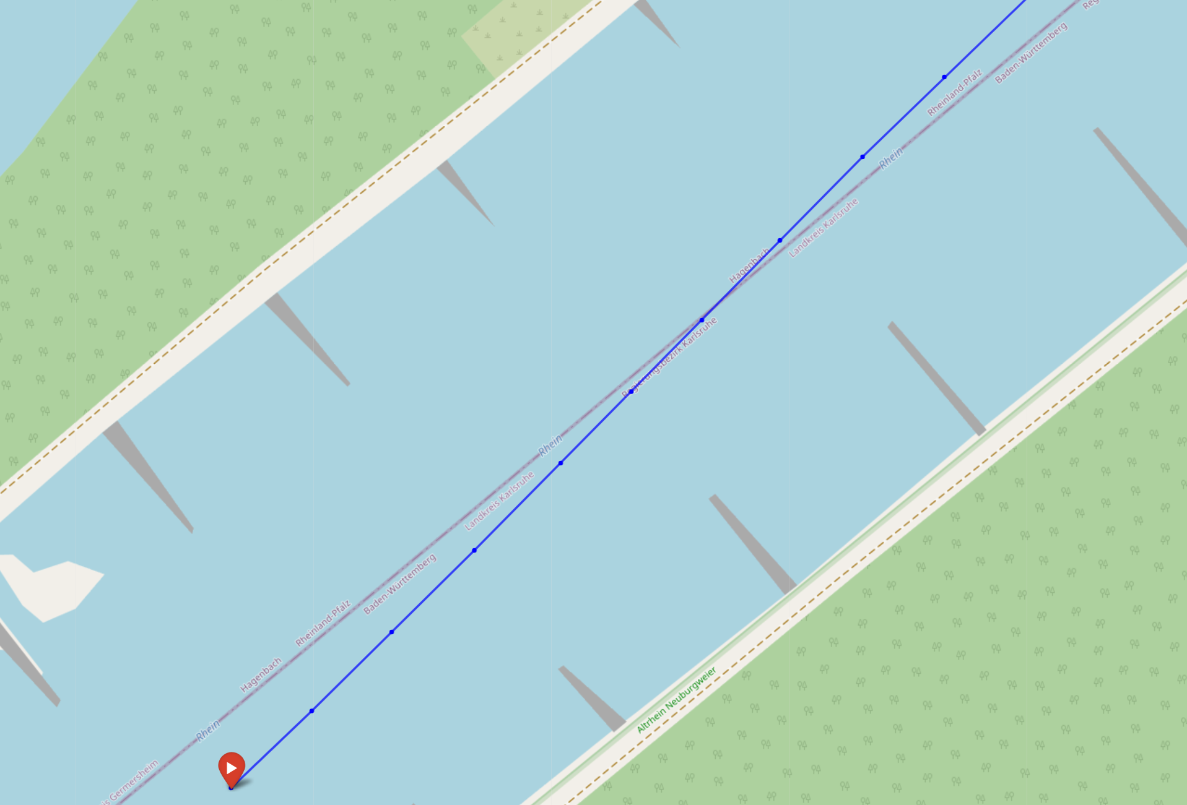

Mechanism
Required correction
Current direction
Deviation
Fairway line
path predicted by model
start point
Presentation of Final Results | Nishanth Battu

Slide 17
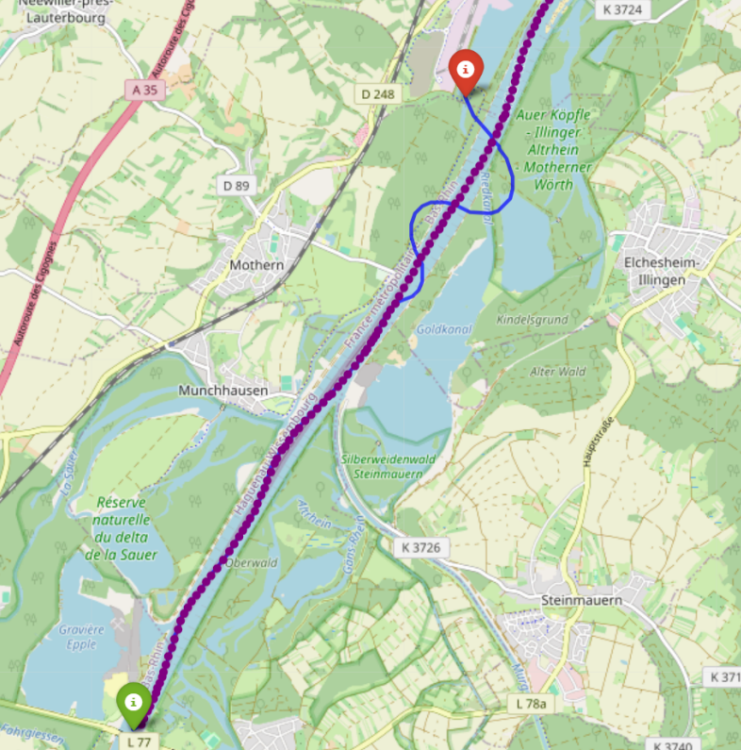
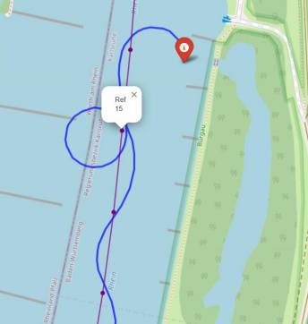
Problems
Presentation of Final Results | Nishanth Battu

Slide 18
Problems
Presentation of Final Results | Nishanth Battu

Slide 19
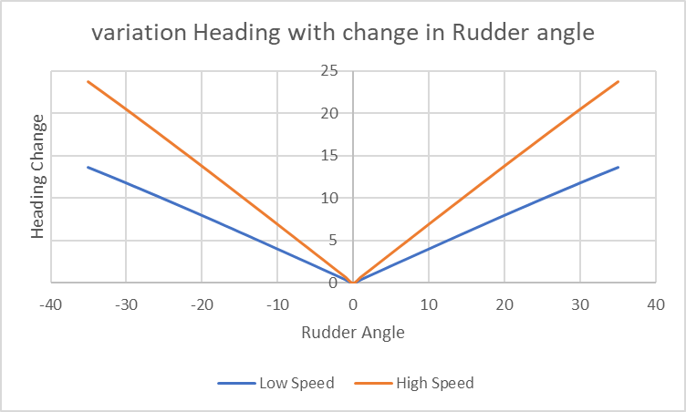
Problems
Presentation of Final Results | Nishanth Battu

Slide 20
Solutions: Every Iteration
Fairway line
path predicted by model
start point
Correction
Presentation of Final Results | Nishanth Battu

Slide 21
Solutions: Target point
Fairway line
path predicted by model
start point
Target Point
Presentation of Final Results | Nishanth Battu

Slide 22
Solutions: Cross Track Error
Fairway line
path predicted by model
start point
Target Point
Cross Track Error
Presentation of Final Results | Nishanth Battu

Slide 23
Evaluation Of Simulated Trajectory
Presentation of Final Results | Aishwarya Chincholi Vasant Madhav

Slide 24
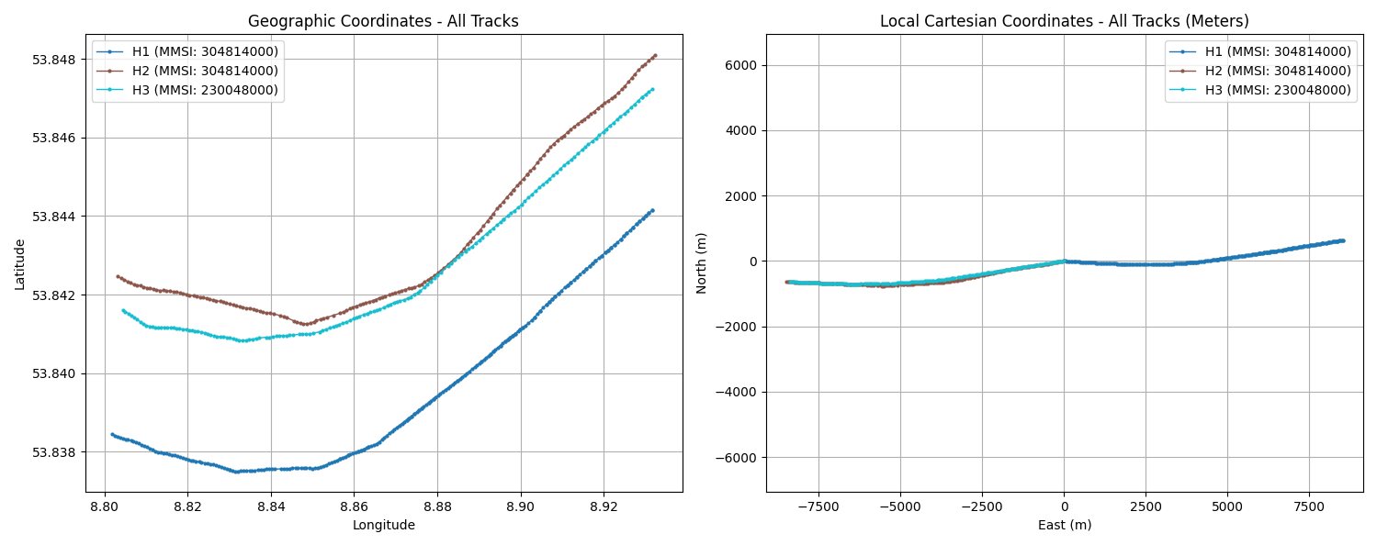
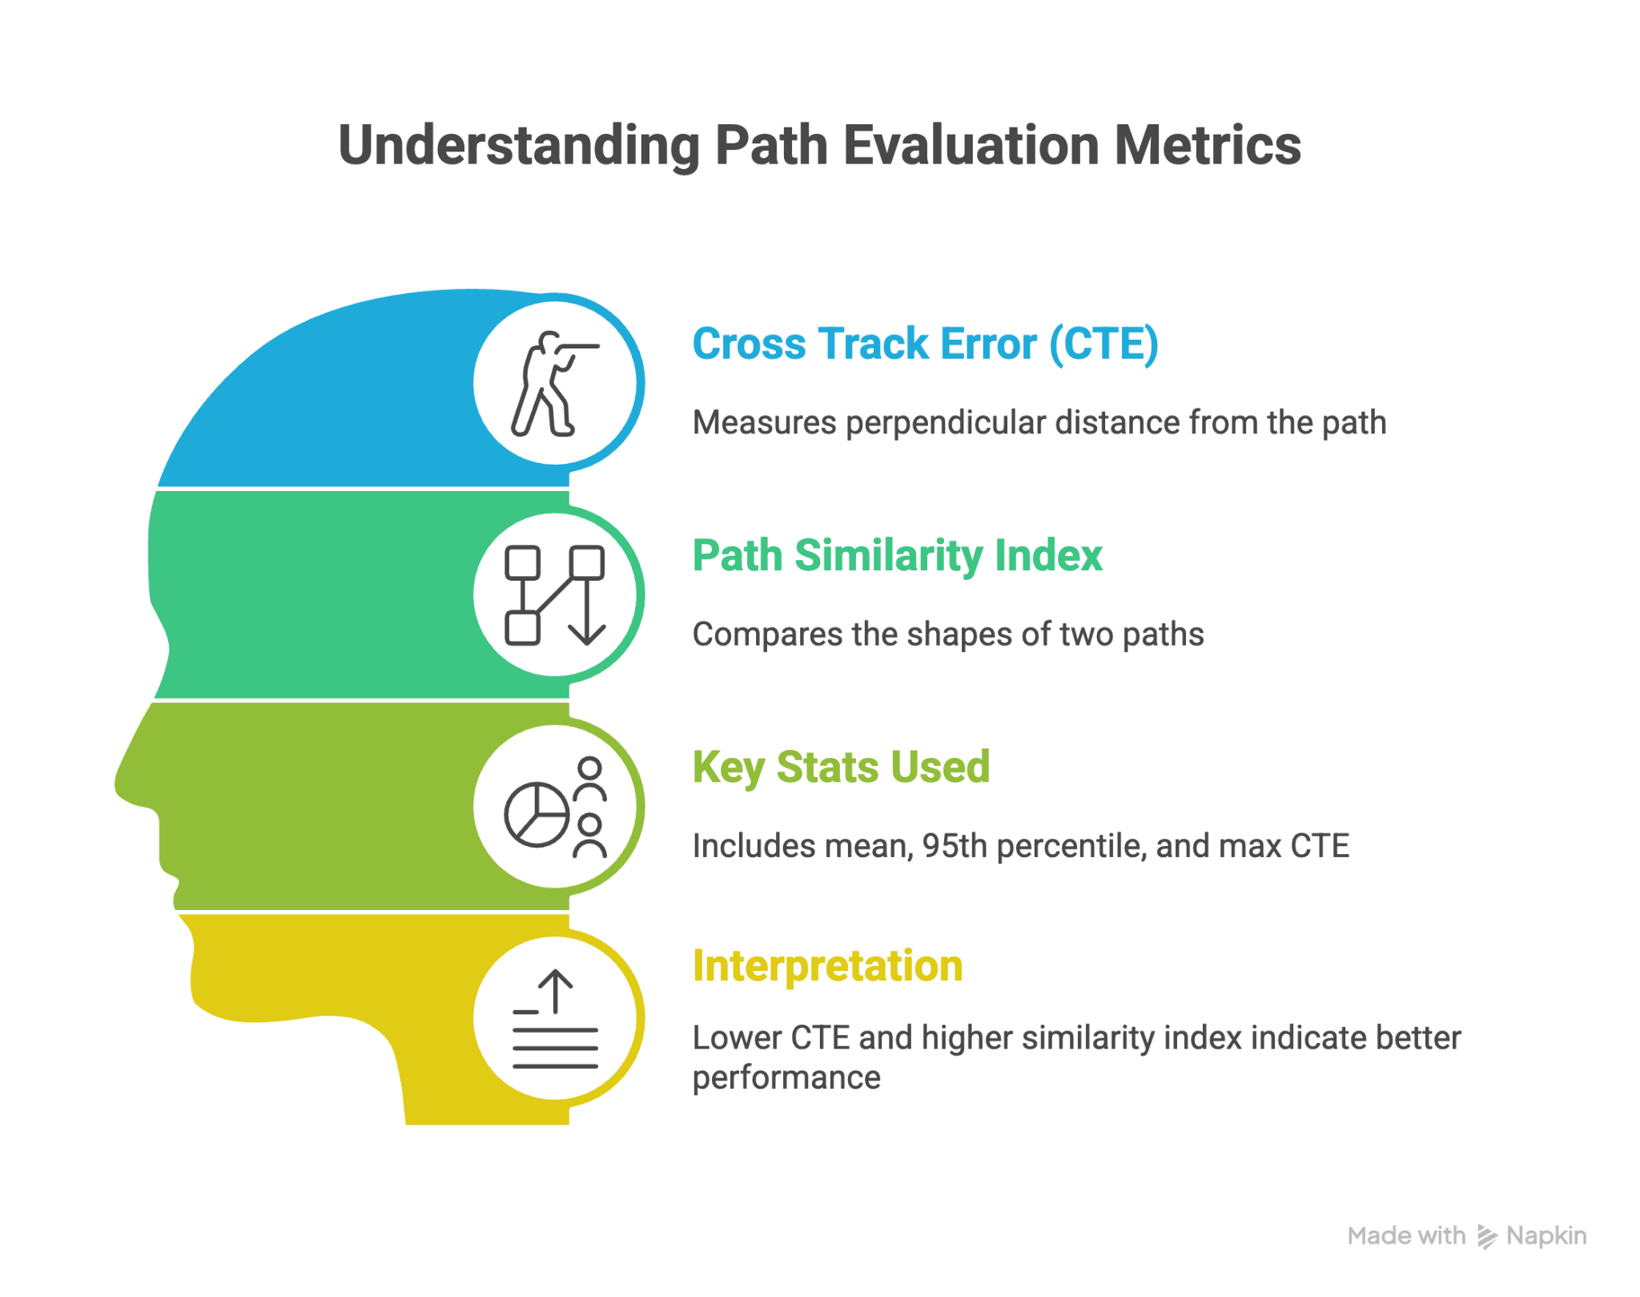
Cuxhaven - Evaluation of Simulated Trajectory
Historical AIS Track
Presentation of Final Results | Aishwarya Chincholi Vasant Madhav

Slide 25
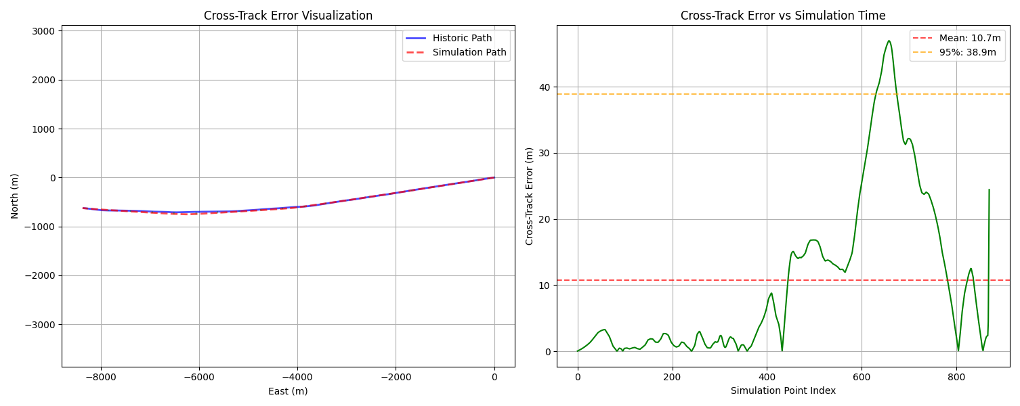
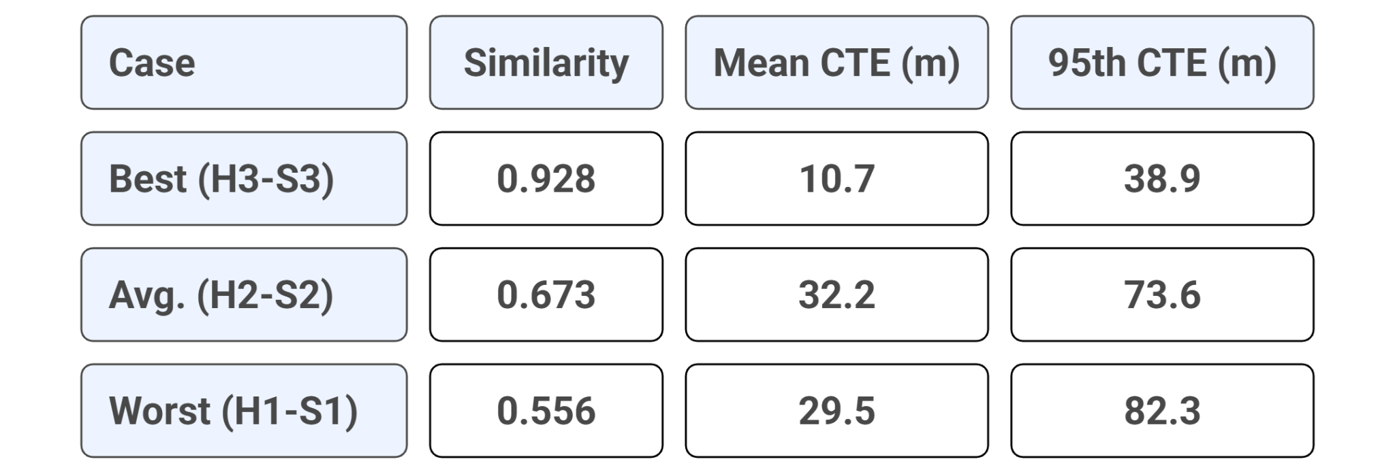
Cuxhaven - Evaluation of Simulated Trajectory
Best Case:H3-S3 Track
Presentation of Final Results | Aishwarya Chincholi Vasant Madhav
Notes:
Worst Case H1-S1:
Path Similarity: 0.556;
Cross Track Error: Mean CTE:29.5 m,
Median CTE: 14.8 m,
95th CTE: 82.3 m, Max CTE: 82.9 m
Average Case H2-S2:
Path Similarity: 0.673;
Cross Track Error: Mean CTE: 32.17 m,
Median CTE: 25.44 m,
95th CTE: 73.64 m, Max CTE: 76.48 m

Slide 26
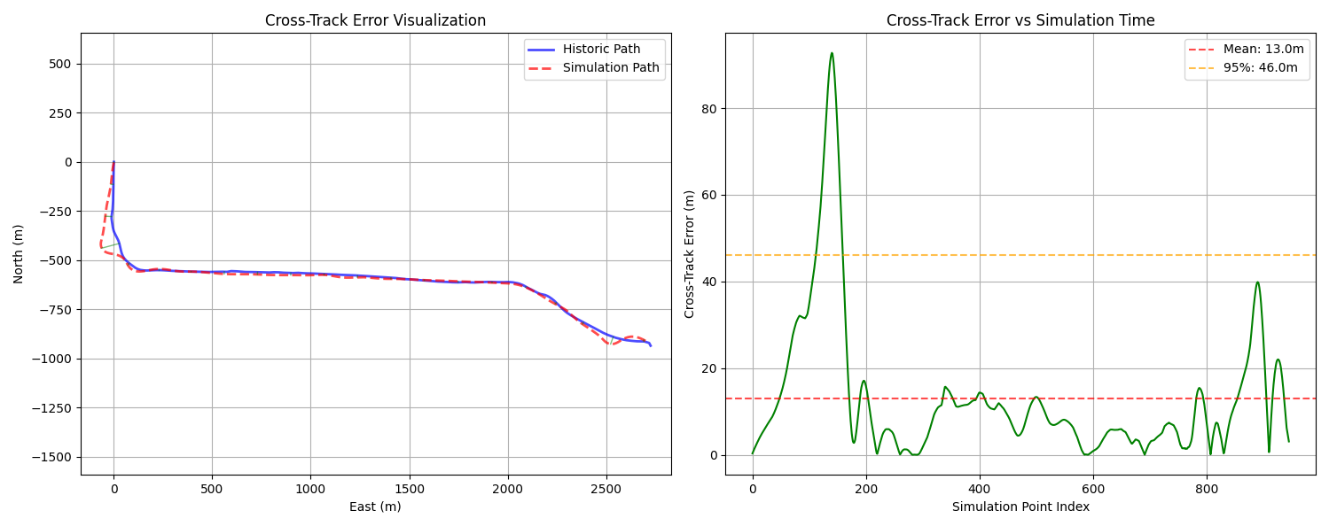
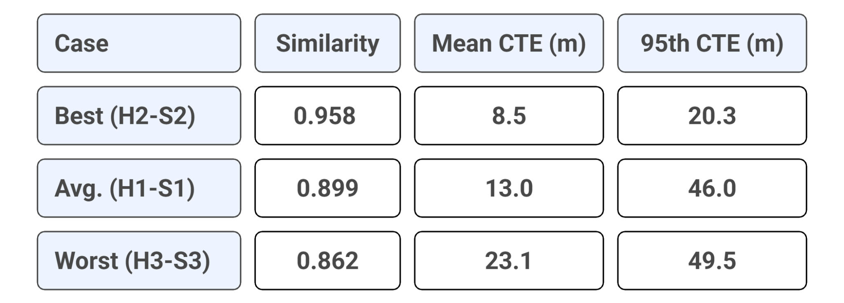
Rheinhafen- Evaluation of Simulated Trajectory
Avg Case: H1-S1 Track
Presentation of Final Results | Aishwarya Chincholi Vasant Madhav

Slide 27
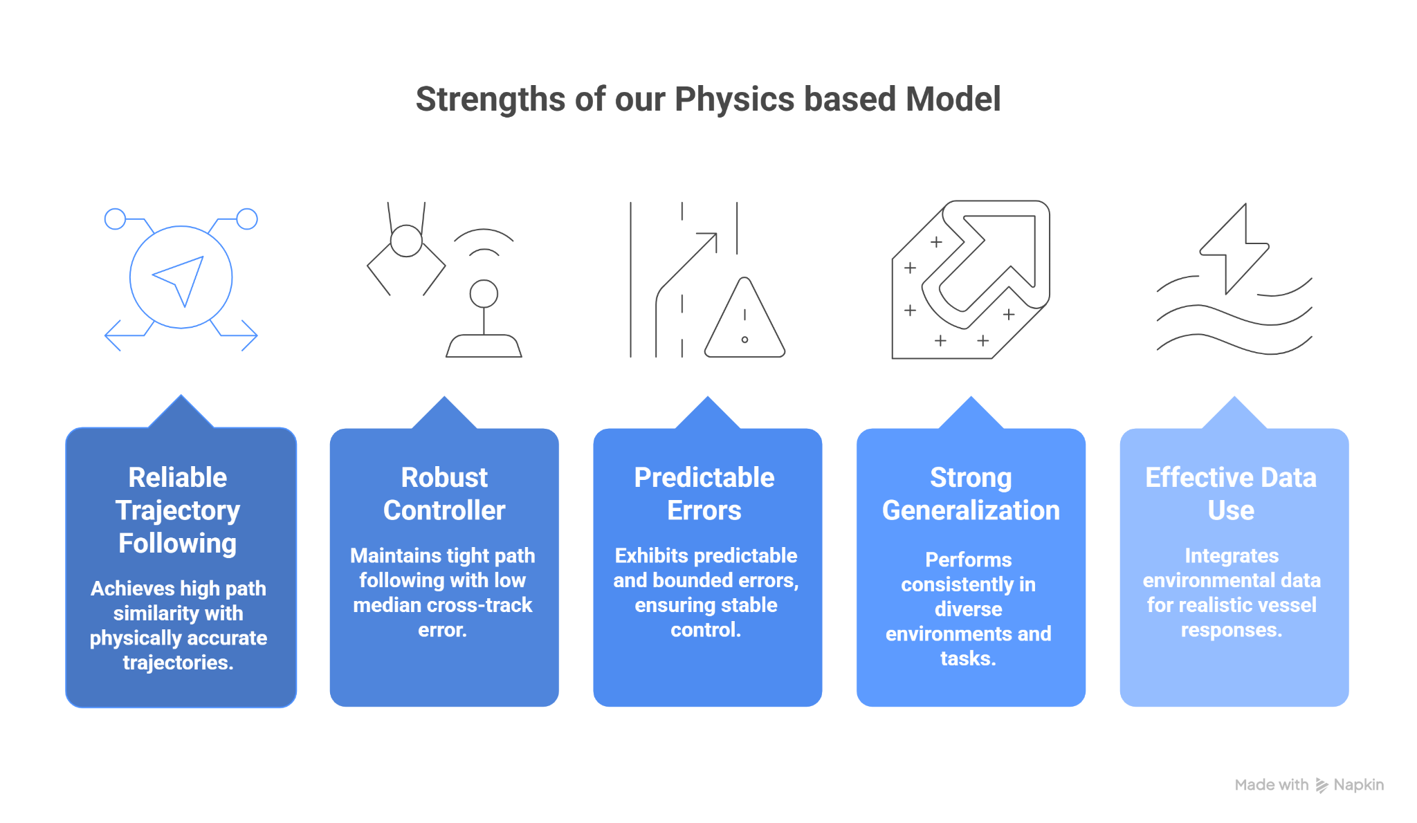
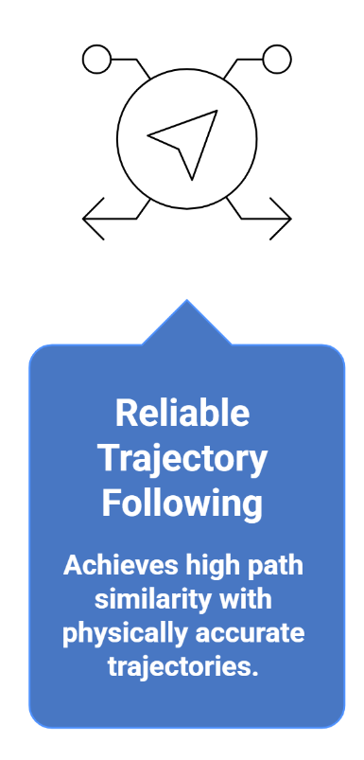
Key Achievements of Our Model
Presentation of Final Results | Aishwarya Chincholi Vasant Madhav

Slide 28
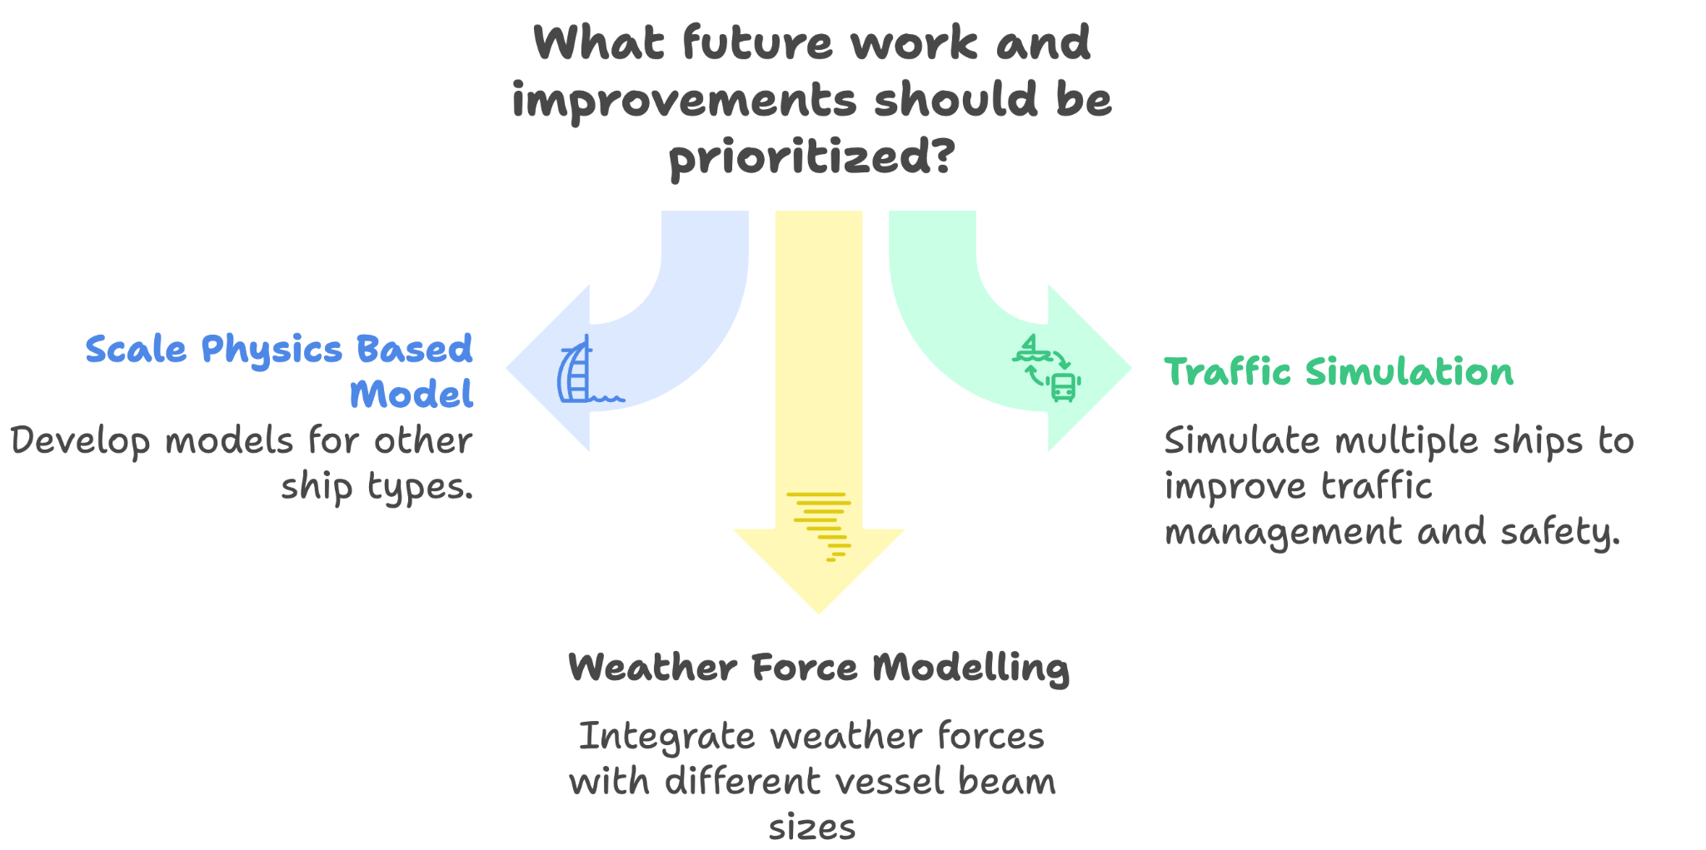
Future Work and Improvements
Presentation of Final Results | Vineet Kumar Agarwal

Slide 29
DEMO TIME!
Presentation of Final Results | Vineet Kumar Agarwal

Slide 30
References
[1] S. Wang, X. Zhang, Y. Zhang, S. Wang, and J. Wang, “A Review of Application of Deep Learning Algorithms in Automatic Modulation Classification,” Digital Signal Process., vol. 110, pp. 102951, Nov. 2021. doi: 10.1016/j.dsp.2021.102951.
[2] Y. Wang, M. Liu, and Z. Wang, “Automatic Modulation Recognition Using Convolutional Neural Networks,” in 2015 IEEE Wireless Communications and Networking Conference (WCNC), New Orleans, LA, USA, 2015, pp. 1665–1670. doi: 10.1109/WCNC.2015.7127715.
[3] S. Wang, Y. Wang, J. Wang, and X. Zhang, “Automatic Modulation Classification Based on Deep Learning for Cognitive Radios,” Sensors, vol. 17, no. 6, Art. no. 1432, Jun. 2017. doi: 10.3390/s17061432.
[4] H. Wang, Y. Liu, and Y. Wang, “A Model for Vessel Trajectory Prediction Based on Long Short-Term Memory Neural Network,” J. Mar. Sci. Eng., vol. 11, no. 10, Art. no. 20464177, Oct. 2019. doi: 10.1080/20464177.2019.1665258.
[5] F.-M. Minßen, J. Klemm, M. Steidel, and A. Niemi, “Predicting Vessel Tracks in Waterways for Maritime Anomaly Detection”, Trans. Marit. Sci., vol. 13, no. 1, Apr. 2024.
[6] Y. Zhou, W. Daamen, T. Vellinga, and S. P. Hoogendoorn, "Impacts of wind and current on ship behavior in ports and waterways: A quantitative analysis based on AIS data," Ocean Eng., vol. 213, p. 107774, Oct. 2020.
Presentation of Final Results | Vineet Kumar Agarwal

Slide 31
References
[7] Y. Zhou, W. Daamen, T. Vellinga, and S. P. Hoogendoorn, "AIS data analysis for the impacts of wind and current on ship behavior in straight waterways," in Developments in Maritime Transportation and Harvesting of Sea Resources, 2017.
[8] K. Nomoto, T. Taguchi, T. Norio, and T. Hirano, “On the steering qualities of ships,” Int. Shipbuild. Progr., vol. 4, no. 35, pp. 354–370, 1957.
[9] L. Barros, G. Pereyra, and D. Caviglia, “Obtaining First and Second Order Nomoto Models of a Fluvial Support Patrol using Identification Techniques,” Rev. Iberoam. Automática Informática Ind., vol. 15, no. 4, pp. 364–374, Dec. 2018.
[10] Y. Yoshimura, “MMG standard method for ship maneuvering predictions,” J. Mar. Sci. Technol., vol. 20, pp. 37–52, 2014. doi: 10.1007/s00773-014-0293-y.
[11] Y. Yoshimura, “Mathematical Model for Manoeuvring Ship Motion (MMG Model),” Proceedings of MARSIM, 2005. [Online]. Available: https://www.researchgate.net/publication/350006339
[12] M. Yasutake and Y. Yoshimura, “Parameter Fine-Tuning Method for MMG Model Using Real-Scale Ship Data,” arXiv preprint, arXiv:2312.04224, 2023. [Online]. Available: https://arxiv.org/abs/2312.04224
Presentation of Final Results | Vineet Kumar Agarwal

Slide 32
References
[13] A. Gerigk and A. Magoga, “Numerical Modeling and Testing of Ship Maneuvering Utilizing CFD and MMG Model,” SSRN Electron. J., 2024. [Online]. Available: https://doi.org/10.2139/ssrn.4673977.
[14] K. Fukami, K. Yamaguchi, H. Yasuda, and T. Miyauchi, “Identification of Ship Maneuvering Behavior Using Singular Value Decomposition and Hydrodynamic Databases,” J. Mar. Sci. Eng., vol. 13, no. 3, Art. no. 496, Mar. 2023. doi: 10.3390/jmse13030496.
[15] M. Yasutake, H. Yasuda, and K. Fukami, “Development of a Mathematical Model for Harbor-Maneuvers to Realize Modeling Automation,” arXiv preprint, arXiv:2302.10459, 2023. [Online]. Available: https://arxiv.org/abs/2302.10459
[16] M. Yasutake and K. Fukami, “System Parameter Exploration of Ship Maneuvering Model Using CMA-ES for Automatic Berthing,” arXiv preprint, arXiv:2111.06124, 2021. [Online]. Available: https://arxiv.org/abs/2111.06124
Presentation of Final Results | Vineet Kumar Agarwal

Slide 33
Simulation and Analysis of Ship Trajectories
Thank You For Your Attention!
Vineet Kumar Agarwal
Nishanth Battu
Aishwarya Chincholi Vasant Madhav

Slide 34
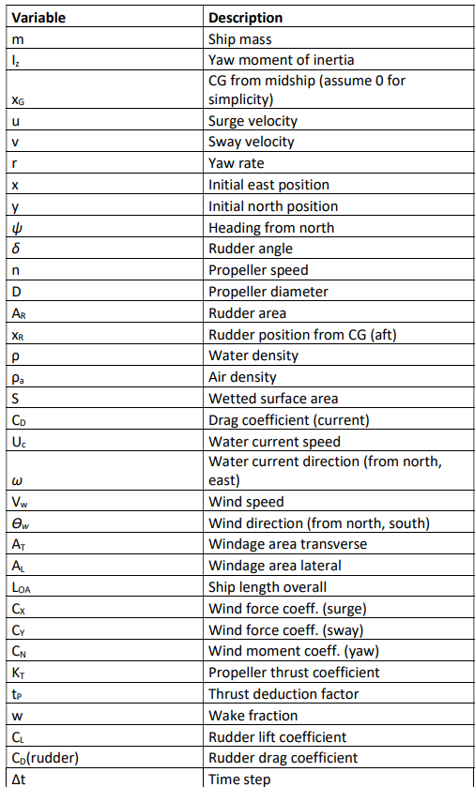
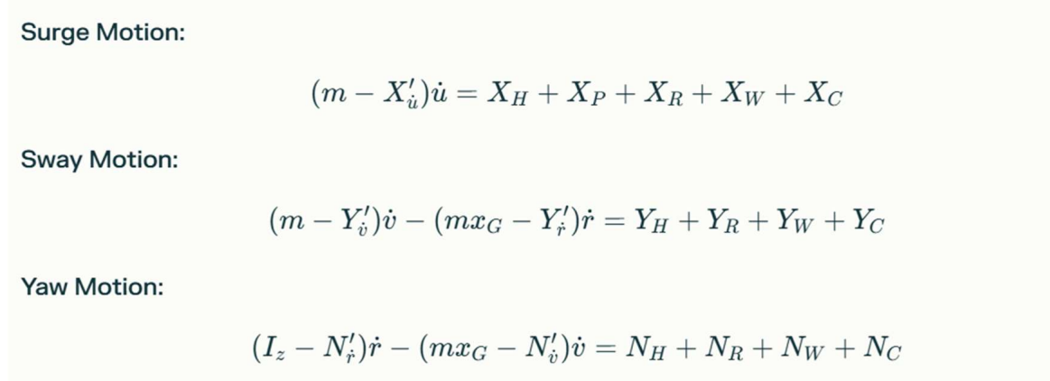
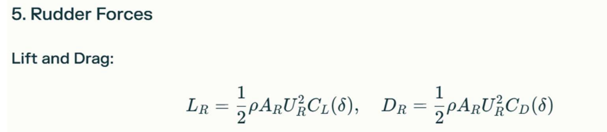
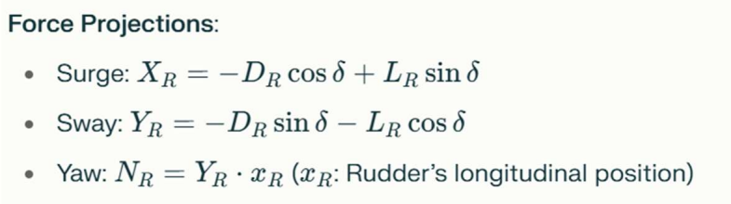
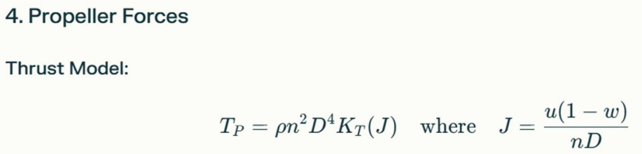
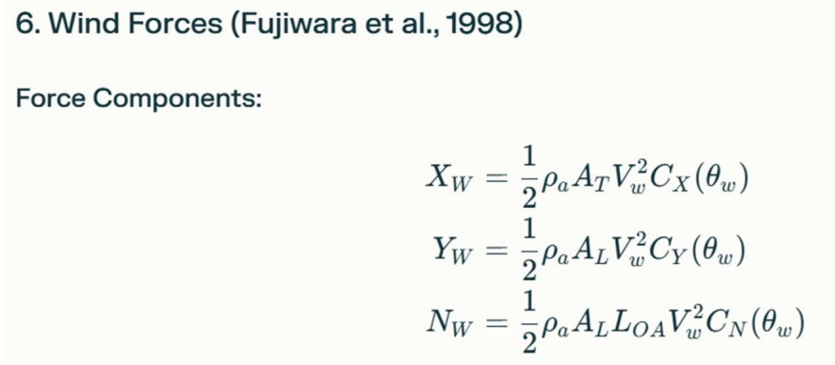
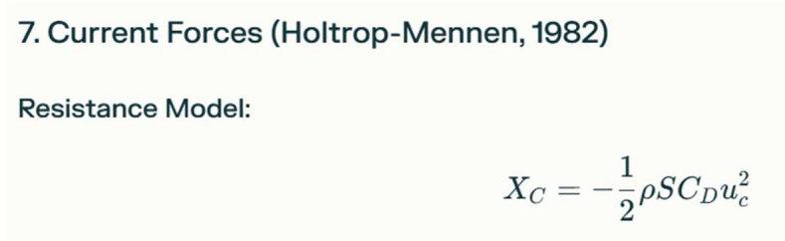
Methodology
Formulas
* references [8-16]

Slide 35
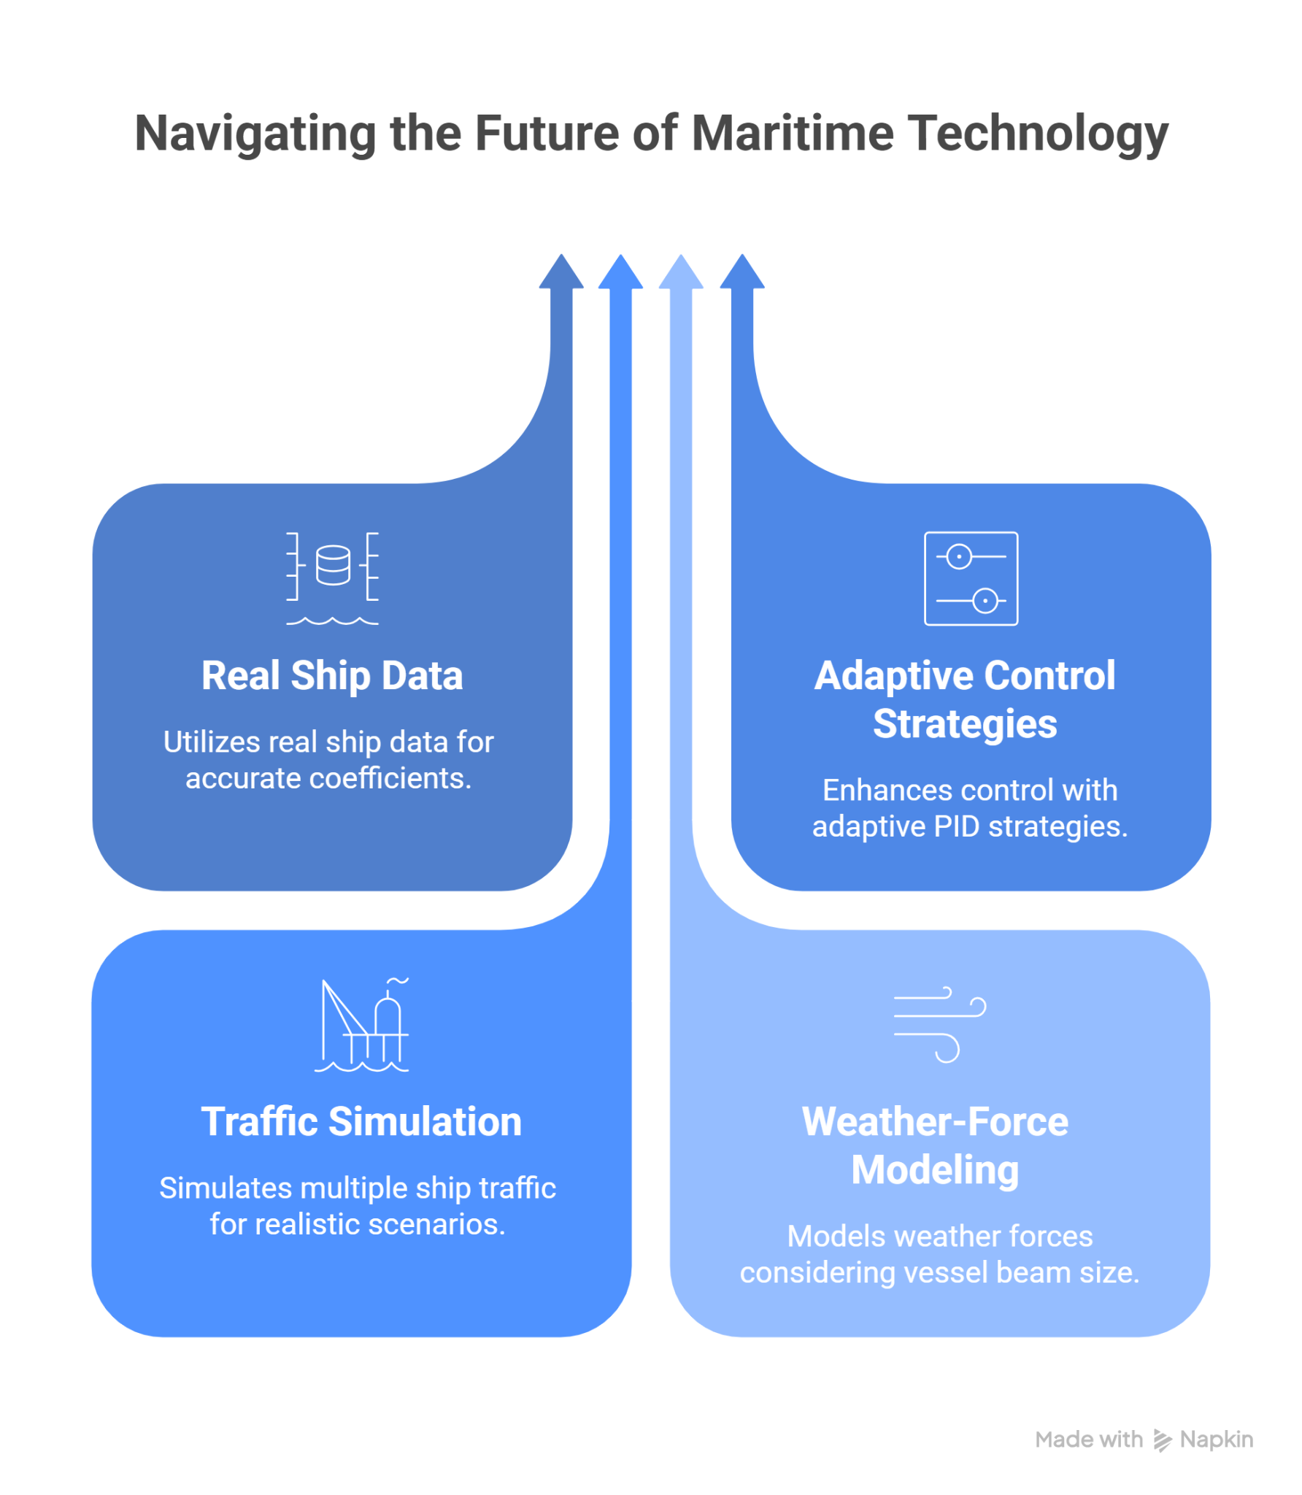
Future Work and Improvements
Presentation of Final Results | Vineet Kumar Agarwal

Slide 36
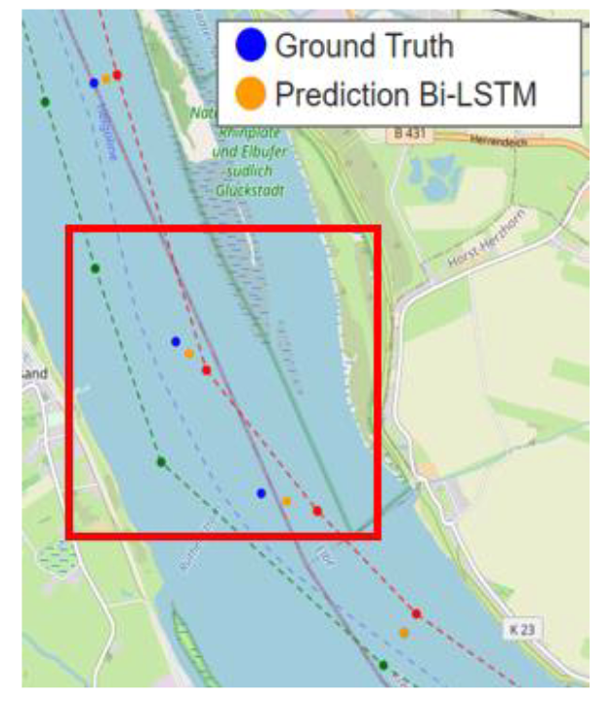
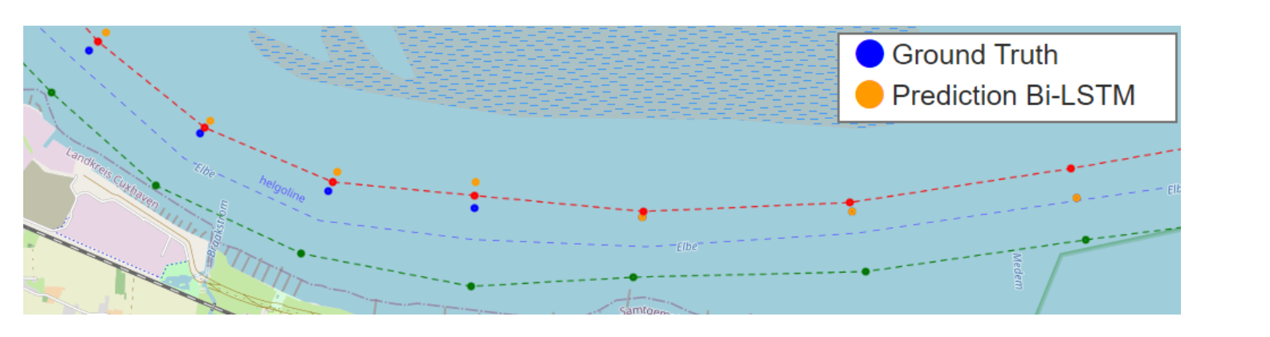
Future Work - Evaluation
Comparing Historical AIS Routes vs Physical Based Calculated routes to see deviations / loss
These images are taken from reference [5]

Slide 37
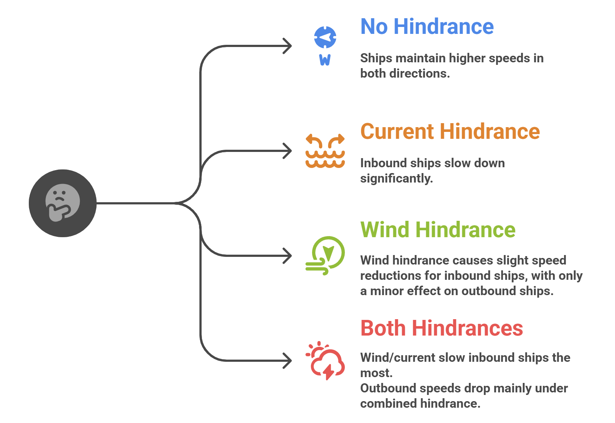
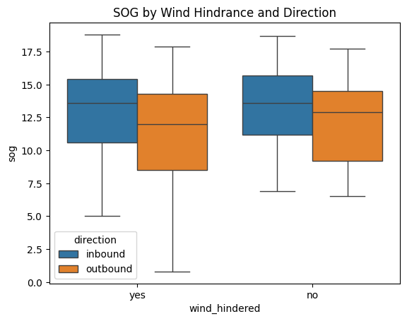
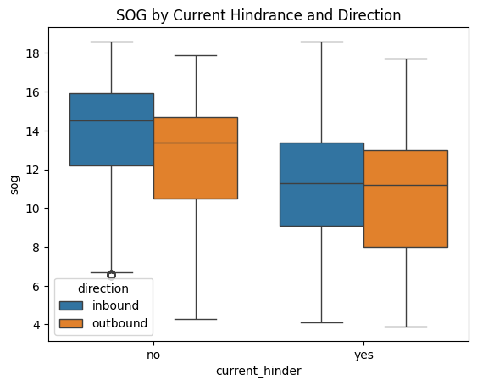
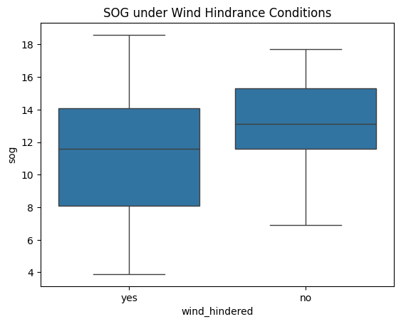
Environmental Analysis - Cuxhaven
Presentation of Final Results | Aishwarya Chincholi Vasant Madhav

Slide 38
Methodology
Aim to generate the trajectory between start and end point.
From the start point it predicts the next point in trajectory with the help of formulas.
It checks with the ais data or with fairway water lines to calculate the deviation
Calculates the correction need to be done with respect to a point which is few iterations away.
It updates the parameters of the ship based on the corrections needed.
Next trajectory is generated.
This process continuous until it reaches end point.

Slide 39
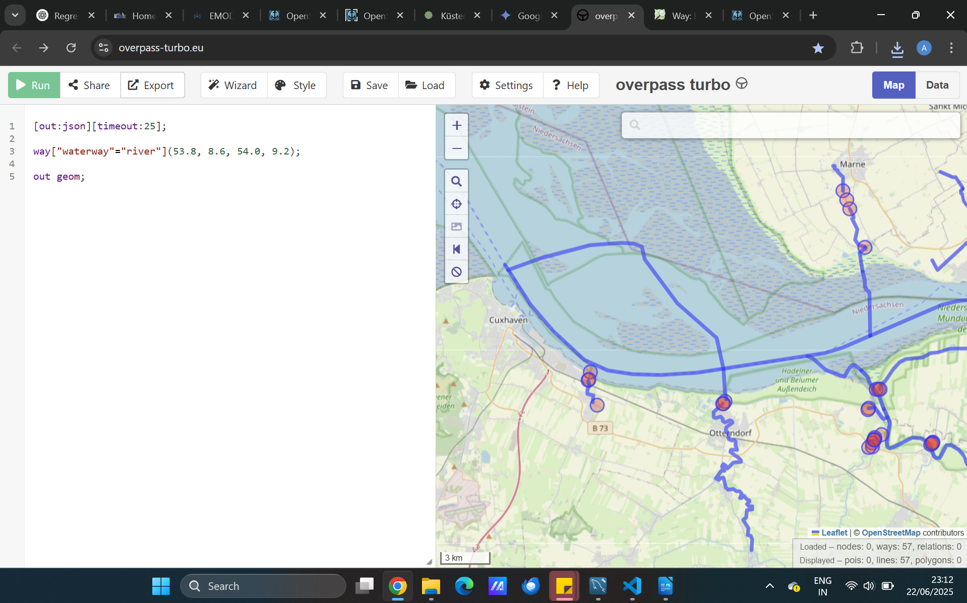
Cuxhaven Fairway Lines
Rivers
Source: https://overpass-turbo.eu/

Slide 40
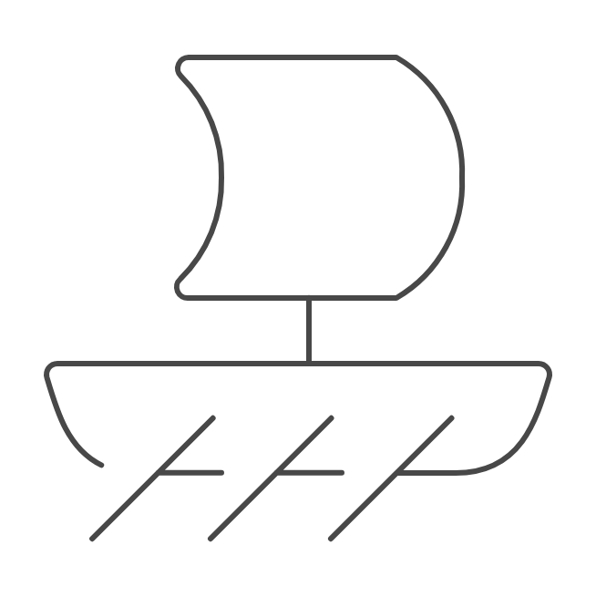
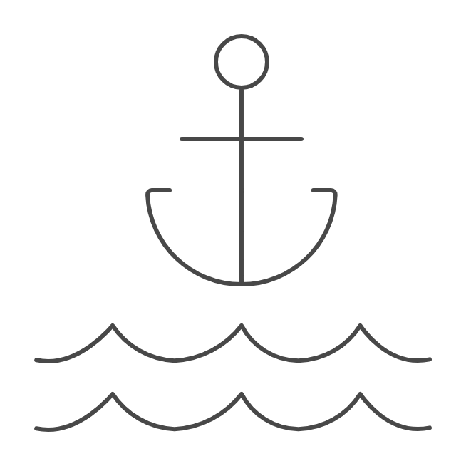
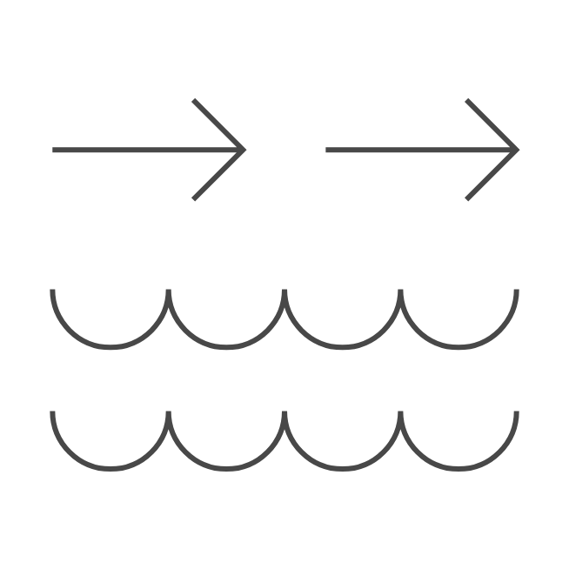
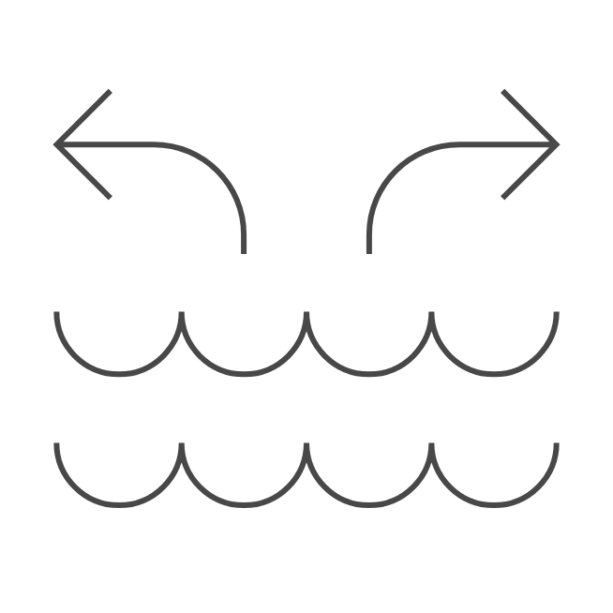
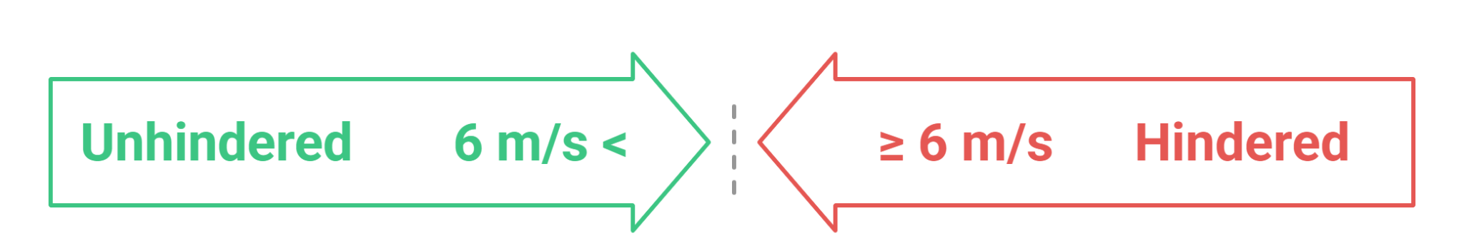
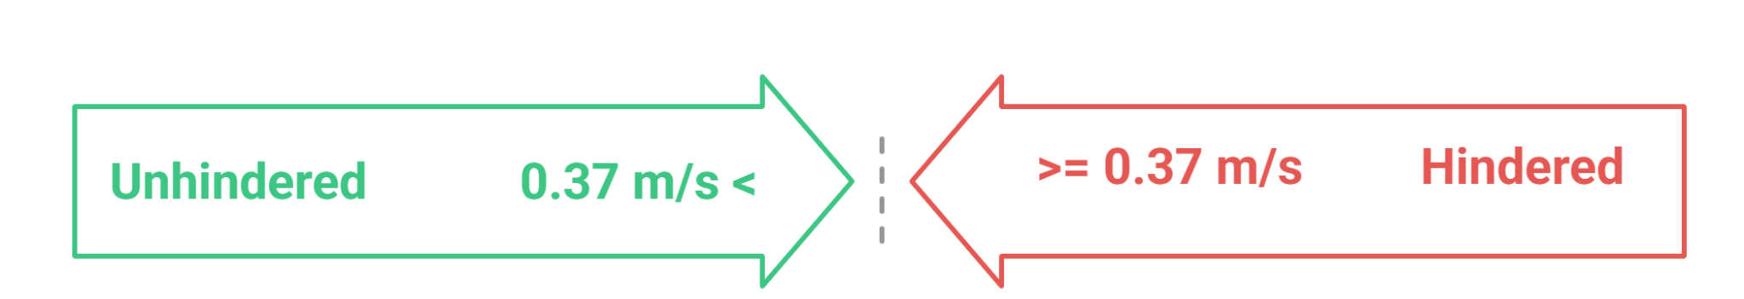
Environmental Analysis - Conditions
Wind Conditions [6]
Visibility>=2000m
Current Conditions [6]
Source for anchorage and port
: https://overpass-turbo.eu/
Notes:
All environmental analysis of SOG, leeway, drift was restricted to unhindered visibility ≥2000 m, to avoid confounding effects.
<2000 m visibility was excluded (or analyzed separately for safety behavior).

Slide 41
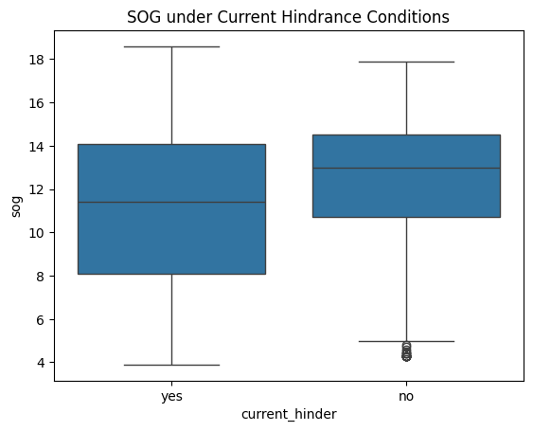
Environmental Analysis - Cuxhaven
SOG under Wind Hindrance Conditions
Condition- ship_type between 60 and 80 and navigational_status =0
SOG under Current Hindrance Conditions

Slide 42
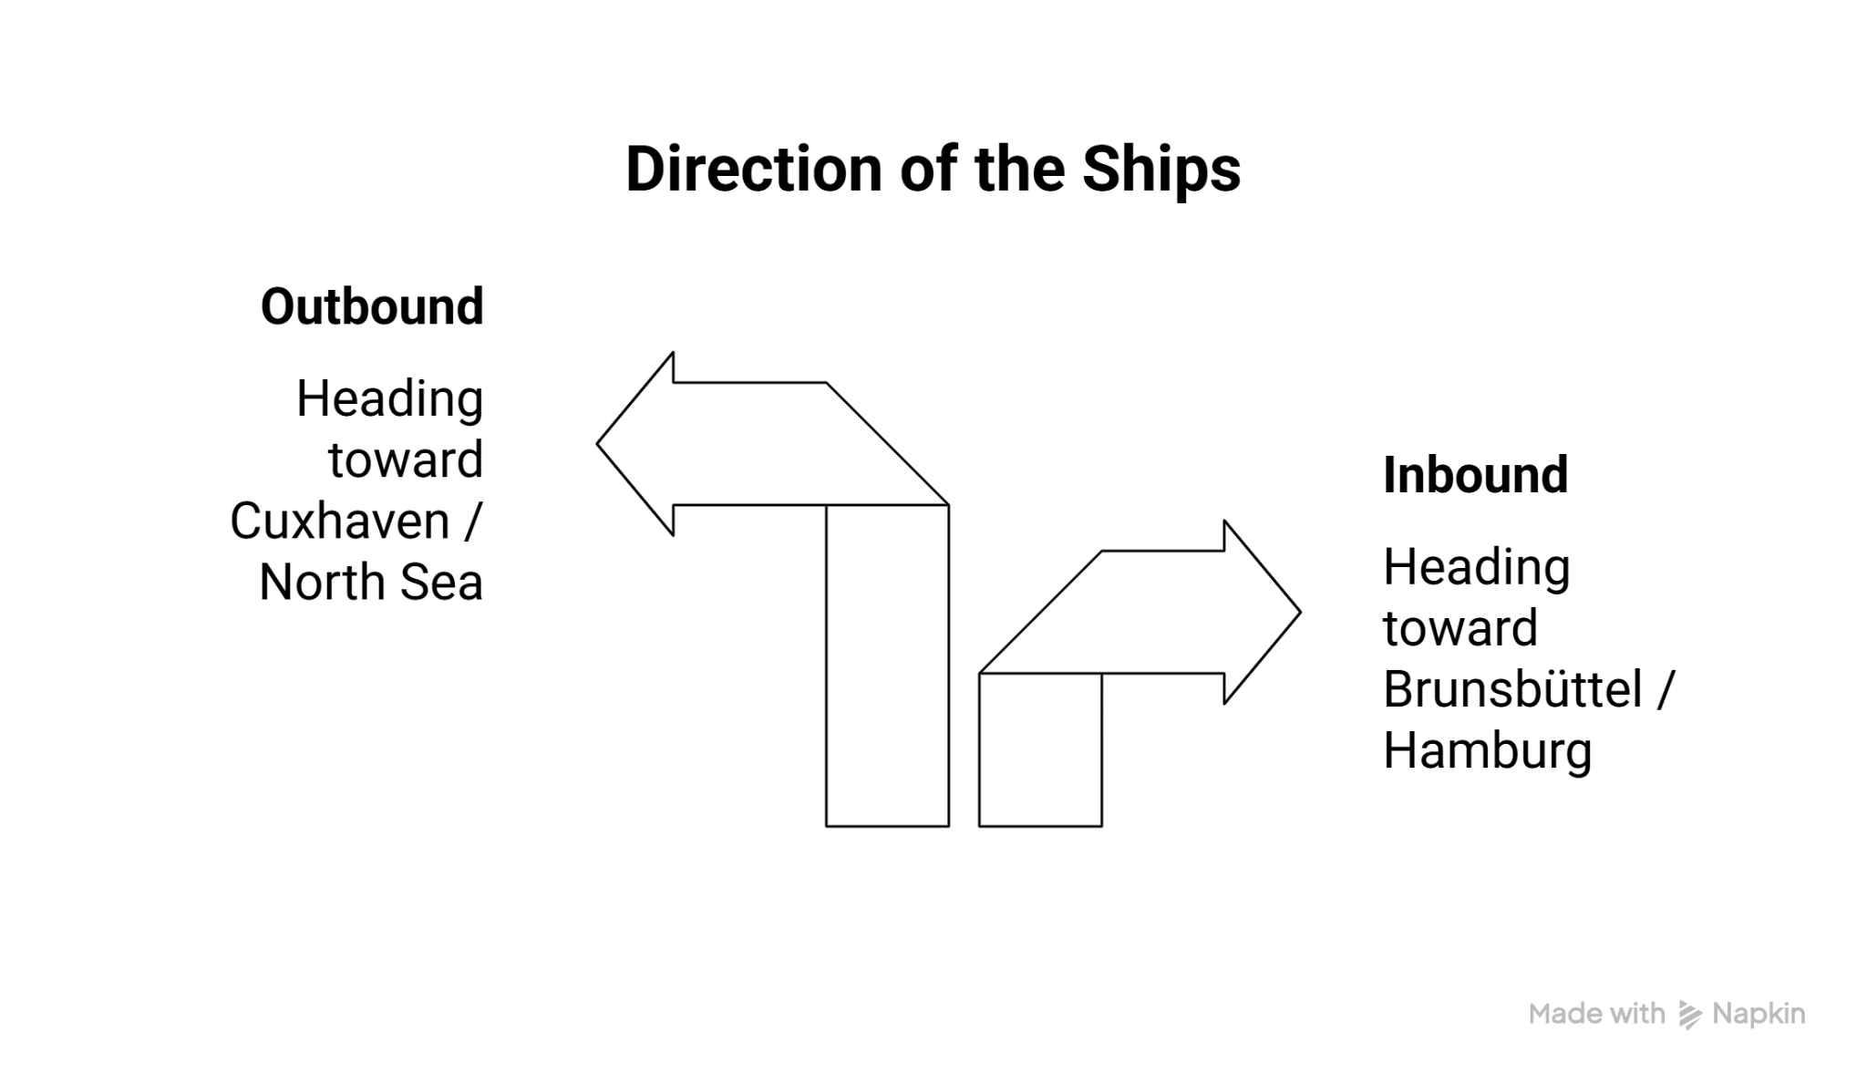
Environmental Analysis - Cuxhaven
SOG by Wind Hindrance and Direction

Slide 43
Environmental Analysis - Cuxhaven
SOG by Current Hindrance and Direction

Slide 44
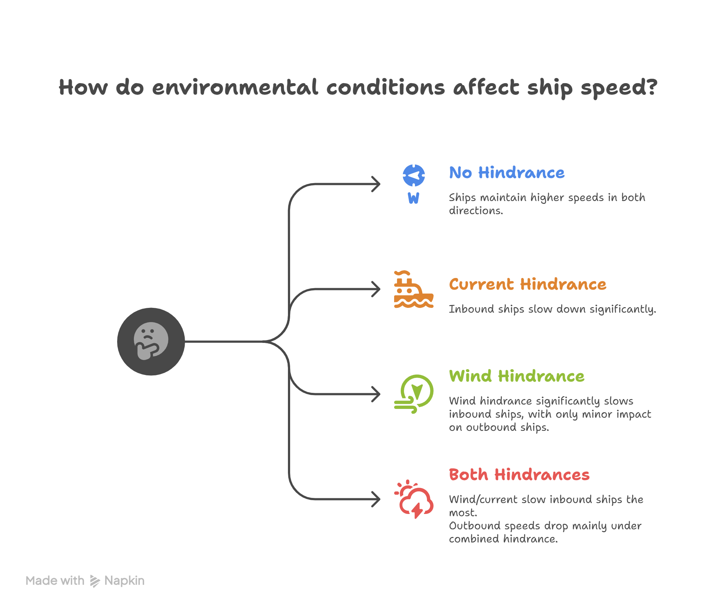
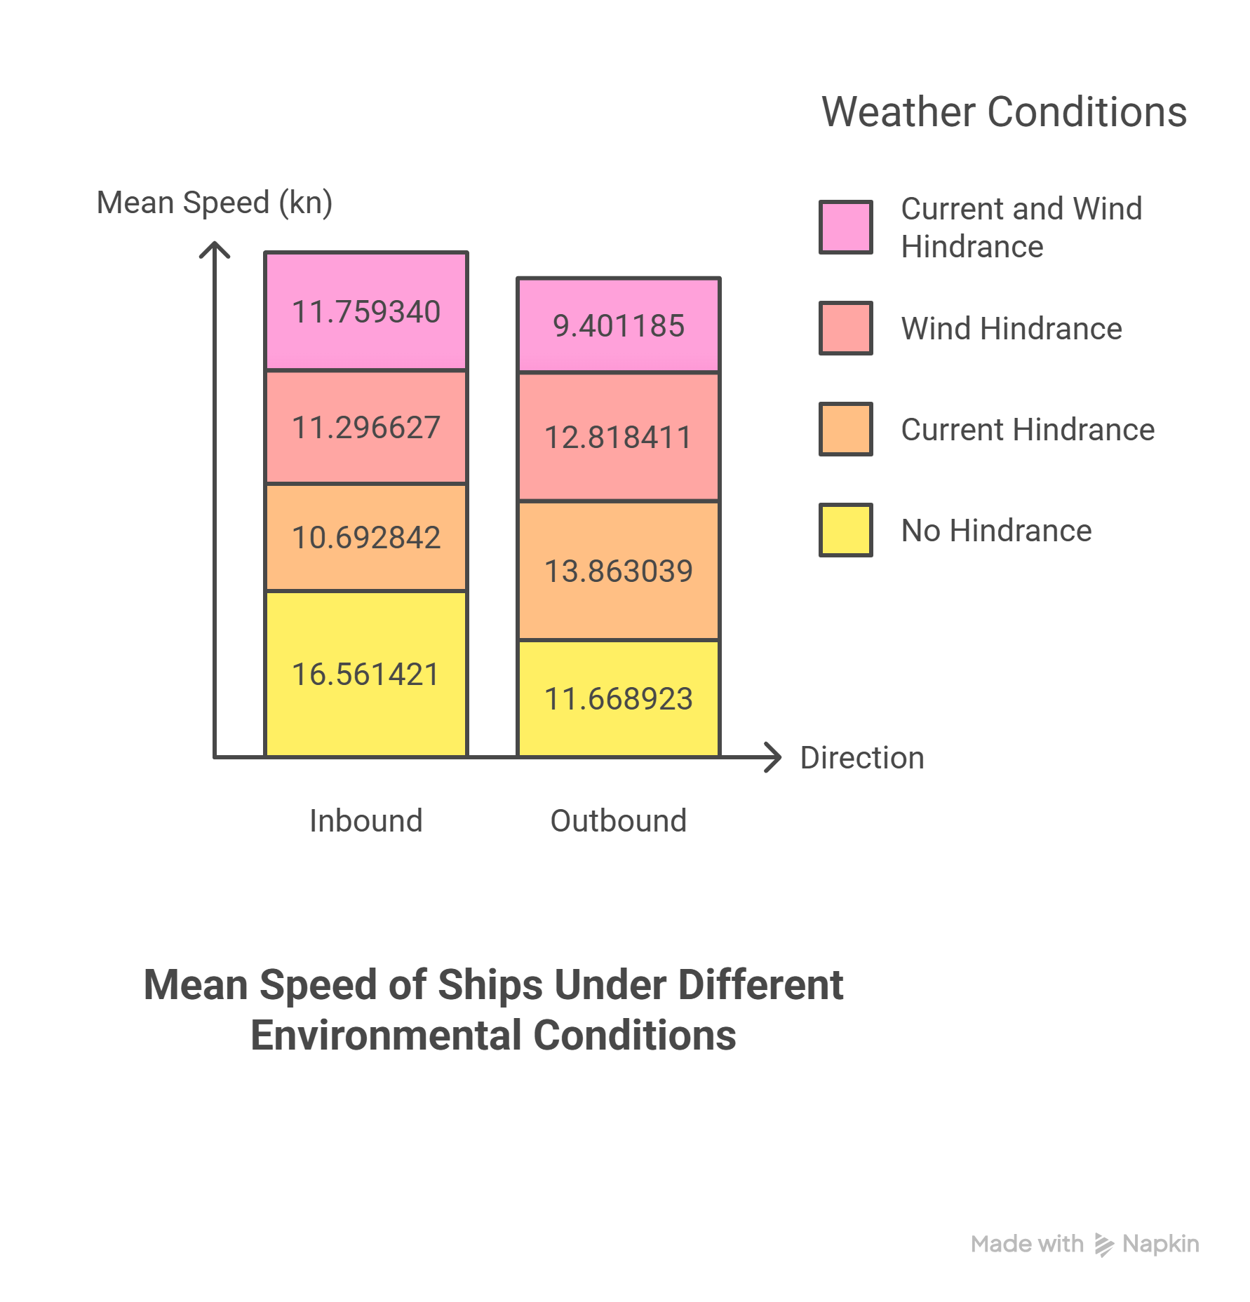
Environmental Analysis - Cuxhaven

Slide 45
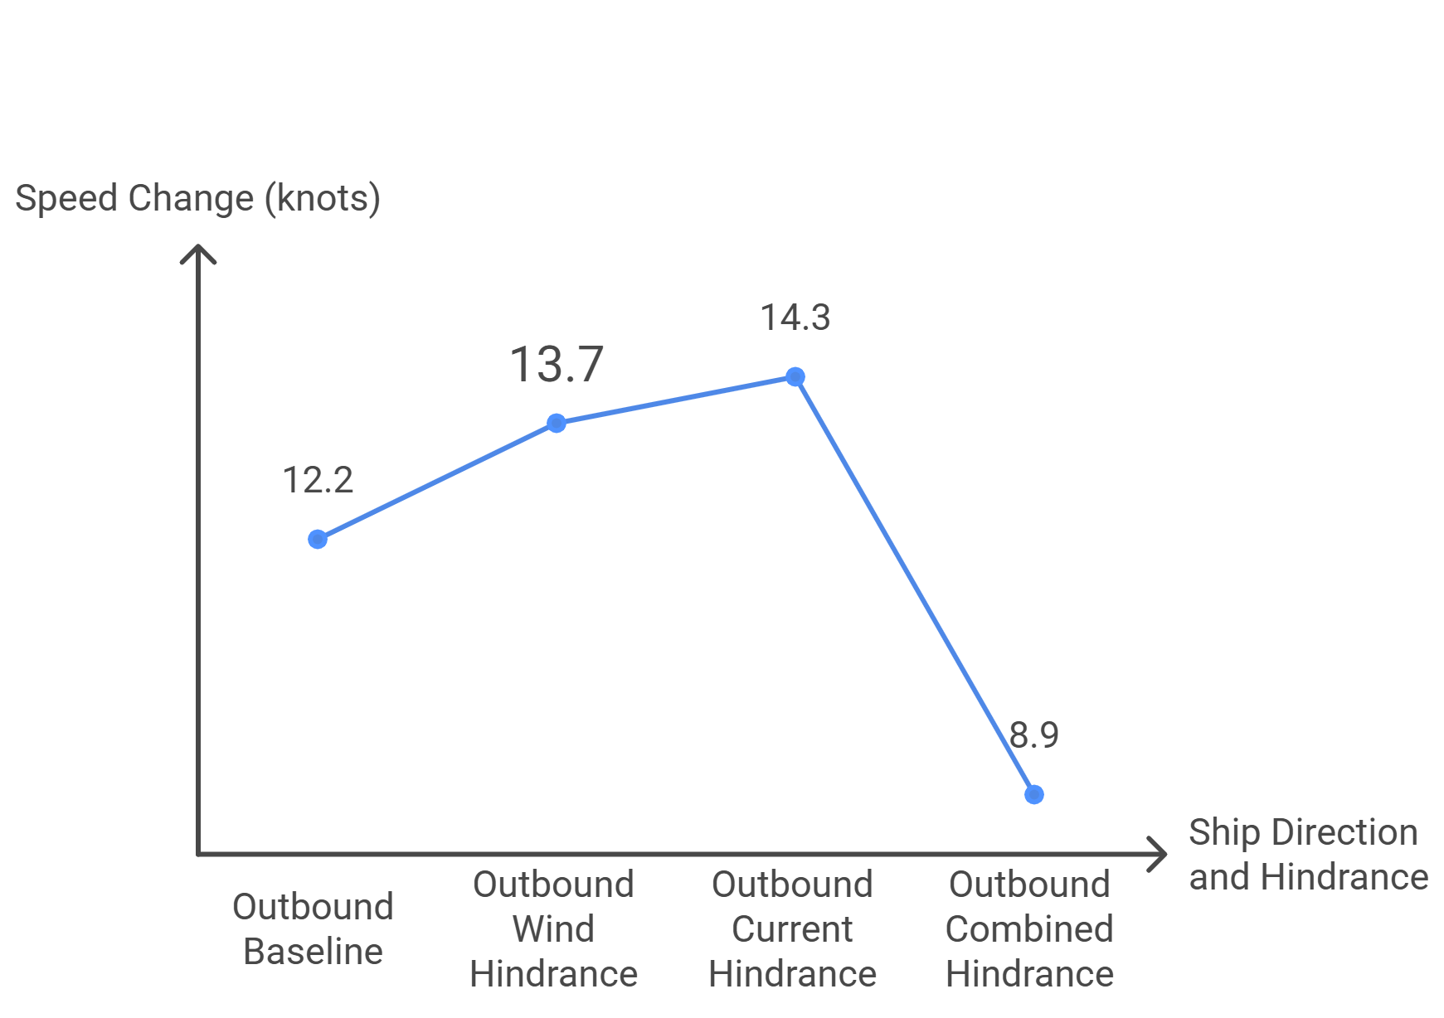

Environmental Analysis - Cuxhaven
Outbound Median Speed Change
Inbound Median Speed Change

Slide 46


Environmental Analysis - Cuxhaven

Slide 47

Environmental Analysis - Cuxhaven
Aspect | Our Finding | Zhao’s Finding [6] | Match
Wind effect magnitude | Very small, mostly negligible | Very small, inconsistent | Yes
Small vessels behavior | Slightly higher medians | Speed patterns influenced by operational factors | Yes
Very large beam vessels | ~1 kn drop | Slight slowdown possible from higher windage | Yes
Current vs wind effect | Wind weaker than current | Wind weaker than current | Yes
[6] Y. Zhou, W. Daamen, T. Vellinga, and S. P. Hoogendoorn, "Impacts of wind and current on ship behavior in ports and waterways: A quantitative analysis based on AIS data," Ocean Eng., vol. 213, p. 107774, Oct. 2020

Slide 48

Milestones and Gantt Chart
Presentation of Final Results | Vineet Kumar Agarwal

Slide 49

Rheinhafen- Evaluation of Simulated Trajectory
H2-S2 Track
Path Similarity 0.958 (excellent);
Cross Track Error: Mean 8.5 m, Median 8.3 m, 95th 20.3 m, Max 21.1 m
→ Tight tracking in constrained water.

Slide 50


Cuxhaven - Evaluation
H1-S1 Track
Path Similarity 0.556;
Cross Track Error : Mean 29.5 m, Median 14.8 m,
95th 82.3 m, Max 82.9 m → Good but needs tuning (large tails).
H2-S2 Track
Path Similarity 0.673;
Cross Track Error : Mean 32.17 m, Median 25.44 m,
95th 73.64 m, 76.48 m → Good; reduce lateral drift in segments with curvature.

Slide 51
Cuxhaven - Evaluation of Simulated Trajectory
Best Case : H3-S3 Track
Worst Case H1-S1:
Path Similarity: 0.556;
Cross Track Error: Mean CTE:29.5 m,
Median CTE: 14.8 m,
95th CTE: 82.3 m, Max CTE: 82.9 m
Average Case H2-S2:
Path Similarity: 0.673;
Cross Track Error: Mean CTE: 32.17 m,
Median CTE: 25.44 m,
95th CTE: 73.64 m, Max CTE: 76.48 m
Best case : Path Similarity: 0.928
CTE : Mean XTE: 10.72 m
Median XTE: 4.33 m
Max XTE: 46.94 m 95th percentile XTE from analysis: 38.87 m
Notes:
Worst Case H1-S1:
Path Similarity: 0.556;
Cross Track Error: Mean CTE:29.5 m,
Median CTE: 14.8 m,
95th CTE: 82.3 m, Max CTE: 82.9 m
Average Case H2-S2:
Path Similarity: 0.673;
Cross Track Error: Mean CTE: 32.17 m,
Median CTE: 25.44 m,
95th CTE: 73.64 m, Max CTE: 76.48 m

Slide 52

Rheinhafen- Evaluation
H1-S1 Track
Average Case H1-S1
Path Similarity: 0.899;
Cross Track Error: Mean 13.0 m, Median 7.8 m,
95th CTE: 46.0 m, Max 92.7 m
H3-S3 Track
Worst Case: H3–S3:
Path Similarity 0.862;
Cross Track Error: Mean 23.1 m, Median 20.6 m,
95th CTE: 49.5 m, Max 53.0 m

Slide 53
Methodology - Heading Mechanism
Mechanism 1
Iteration 1
Iteration 2
Ais or fairway line
path predicted by model
start point

Slide 54
Methodology - Heading Mechanism
Mechanism 1
Iteration 1
Iteration 2
Iteration n
Ais or fairway line
path predicted by model
start point

Slide 55
Heading Mechanism : Correction
Add the markings on the image and cover the image full slide
Ais or fairway line
path predicted by model
start point
Deviation

Slide 56
Methodology - Heading Mechanism
Mechanism 1
Correction
Required correction
Current direction
Deviation

Slide 57
Methodology - Heading Mechanism
Mechanism 1
Correction

Slide 58


Evolution of Ship Trajectory

Slide 59


Evaluation of Ship Trajectory
Change the main heading wrt the problem solved in each slide

Slide 60

Evolution of Ship Trajectory - better slide title

Slide 61

Problems

Slide 62
Solutions
Solutions for above problems
Deviation is checked for each iteration.
Target point for correction is the next point.
Introduced Cross Track Error(CTE) for the current position.
Rudder angle is controlled as a weighted sum of heading error, CTE and speed of the ship.
Subheading as main heading and explain with images

Slide 63

Rheinhafen Port Area
polygon 1
polygon 2
polygon 3
polygon 4
polygon 5
polygon 6

Slide 64


Line of sight for Rheinhafen port area

Slide 65

Line of sight for Rheinhafen port area

Slide 66
Line of sight for Rheinhafen port area

Slide 67


